Slide 1
The SWIFT PROGRAMMING LANGUAGE 4.2
Edwin Wu

Slide 2
The Basics
Basic Operators
Strings and Characters
Collection Types
Control Flow
Functions
Closures
Enumerations
Structures and Classes
Properties
Methods
Subscripts
Inheritance
Initialization
Deinitialization
Optional Chaining
Error handling
Type Casting
Nested Types
Extensions
Protocols
Generics
Automatic Reference Counting
Memory Safety
Access Control
Advanced Operators

Slide 3
The Basics
Constants and Variables
Comments
Semicolons
Integers
Floating-Point Numbers
Type Safety and Type Inference
Numeric Literals
Numeric Type Conversion
Type Aliases
Booleans
Tuples
Optionals
Error Handling
Assertions and Preconditions

Slide 4
Basic types : Int(Int8, UInt8, Int32, UInt32, Int64, UInt64), Double, Float, Bool, String
Collection types: Array, Set, Dictionary
Advanced types: Tuple
Optional
Type-safe language
Notes:
Swift is a type-safe language, which means the language helps you to be clear about the types of values your code can work with. If part of your code requires a String, type safety prevents you from passing it an Int by mistake. Likewise, type safety prevents you from accidentally passing an optional String to a piece of code that requires a nonoptional String. Type safety helps you catch and fix errors as early as possible in the development process.

Slide 5
Constants and Variables
Constants with the let keyword
let maximumNumberOfLoginAttempts:Int
let maximumNumberOfLoginAttempts = 10
Variables with the var keyword
var currentLoginAttempt:Int
var currentLoginAttempt = 0
Notes:
NOTE
It’s rare that you need to write type annotations in practice. If you provide an initial value for a constant or variable at the point that it’s defined, Swift can almost always infer the type to be used for that constant or variable, as described in Type Safety and Type Inference. In the welcomeMessage example above, no initial value is provided, and so the type of the welcomeMessage variable is specified with a type annotation rather than being inferred from an initial value.

Slide 6
Comments
// This is a comment.
/* This is also a comment but is written over multiple lines. */
nested
/* This is the start of the first multiline comment.
/* This is the second, nested multiline comment. */ This is the end of the first multiline comment. */

Slide 7
Semicolons
let cat = "🐱"
print(cat)
let cat = "🐱"; print(cat)
// Prints "🐱"
Notes:
Unlike many other languages, Swift doesn’t require you to write a semicolon (;) after each statement in your code, although you can do so if you wish. However, semicolons arerequired if you want to write multiple separate statements on a single line:

Slide 8
Integers
On a 32-bit platform, Int is the same size as Int32
On a 32-bit platform, UInt is the same size as UInt32
On a 64-bit platform, Int is the same size as Int64
On a 64-bit platform, UInt is the same size as UInt64
Notes:
NOTE
Use UInt only when you specifically need an unsigned integer type with the same size as the platform’s native word size. If this isn’t the case, Int is preferred, even when the values to be stored are known to be nonnegative. A consistent use of Int for integer values aids code interoperability, avoids the need to convert between different number types, and matches integer type inference, as described in Type Safety and Type Inference.

Slide 9
Floating-Point Numbers
Double represents a 64-bit floating-point number
Float represents a 32-bit floating-point number
Notes:
NOTE
Double has a precision of at least 15 decimal digits, whereas the precision of Float can be as little as 6 decimal digits. The appropriate floating-point type to use depends on the nature and range of values you need to work with in your code. In situations where either type would be appropriate, Double is preferred.

Slide 10
Type Safety and Type Inference
Swift is a type-safe language
Type inference
let meaningOfLife = 42
// meaningOfLife is inferred to be of type Int
let pi = 3.14159 // pi is inferred to be of type Double
let anotherPi = 3 + 0.14159
// anotherPi is also inferred to be of type Double
Notes:
Swift is a type-safe language. A type safe language encourages you to be clear about the types of values your code can work with. If part of your code requires a String, you can’t pass it an Int by mistake.

Slide 11
Numeric Type Conversion
Integer literals
A decimal number, with no prefix
A binary number, with a 0b prefix
An octal number, with a 0o prefix
A hexadecimal number, with a 0x prefix
let decimalInteger = 17
let binaryInteger = 0b10001 // 17 in binary notation let octalInteger = 0o21 // 17 in octal notation let hexadecimalInteger = 0x11 // 17 in hexadecimal notation

Slide 12
Numeric Literals
Integer literals
A decimal number, with no prefix
A binary number, with a 0b prefix
An octal number, with a 0o prefix
A hexadecimal number, with a 0x prefix
let decimalInteger = 17
let binaryInteger = 0b10001 // 17 in binary notation let octalInteger = 0o21 // 17 in octal notation let hexadecimalInteger = 0x11 // 17 in hexadecimal notation

Slide 13
Floating-point literals
1.25e2 means 1.25 x 10², or 125.0
1.25e-2 means 1.25 x 10⁻², or 0.0125
0xFp2 means 15 x 2², or 60.0
0xFp-2 means 15 x 2⁻², or 3.75
let decimalDouble = 12.1875
let exponentDouble = 1.21875e1
let hexadecimalDouble = 0xC.3p0

Slide 14
Both integers and floats can be padded with extra zeros and can contain underscores to help with readability.
let paddedDouble = 000123.456
let oneMillion = 1_000_000
let justOverOneMillion = 1_000_000.000_000_1

Slide 15
Numeric Type Conversion
Use the Int type for all general-purpose
Integer Conversion
let cannotBeNegative: UInt8 = -1 // UInt8 cannot store negative numbers, and so this will report an error let tooBig: Int8 = Int8.max + 1 // Int8 cannot store a number larger than its maximum value, // and so this will also report an error

Slide 16
SomeType(ofInitialValue)
let twoThousand: UInt16 = 2_000 let one: UInt8 = 1 let twoThousandAndOne = twoThousand + UInt16(one)

Slide 17
Integer and Floating -Point Conversion
let three = 3 let pointOneFourOneFiveNine = 0.14159 let pi = Double(three) + pointOneFourOneFiveNine // pi equals 3.14159, and is inferred to be of type Double
Floating-point to integer conversion must also be made explicit
let integerPi = Int(pi) // integerPi equals 3, and is inferred to be of type Int
Notes:
NOTE
The rules for combining numeric constants and variables are different from the rules for numeric literals. The literal value 3 can be added directly to the literal value 0.14159, because number literals don’t have an explicit type in and of themselves. Their type is inferred only at the point that they’re evaluated by the compiler.

Slide 18
Type Aliases
typealias AudioSample = UInt16
var maxAmplitudeFound = AudioSample.min // maxAmplitudeFound is now 0

Slide 19
Booleans
Bool (true/false)
let orangesAreOrange = true let turnipsAreDelicious = false
if turnipsAreDelicious {
print("Mmm, tasty turnips!")
} else {
print("Eww, turnips are horrible.")
}
// Prints "Eww, turnips are horrible."

Slide 20
Tuples
Tuples group multiple values into a single compound value
Tuples are particularly useful as the return values of functions
let http404Error = (404, "Not Found") // http404Error is of type (Int, String), and equals (404, "Not Found")
let (statusCode, statusMessage) = http404Error print("The status code is \(statusCode)") // Prints "The status code is 404" print("The status message is \(statusMessage)") // Prints "The status message is Not Found"
Notes:
NOTE
Tuples are useful for temporary groups of related values. They’re not suited to the creation of complex data structures. If your data structure is likely to persist beyond a temporary scope, model it as a class or structure, rather than as a tuple. For more information, see Structures and Classes.

Slide 21
Optionals
An optional represents two possibilities: Either there is a value, and you can unwrap the optional to access that value, or there isn’t a value at all(nil).
var cash: Int? cash = 100
print(cash!)
let possibleNumber = "123"
let convertedNumber = Int(possibleNumber)
// convertedNumber is inferred to be of type "Int?", or "optional Int"
Notes:
NOTE
The concept of optionals doesn’t exist in C or Objective-C. The nearest thing in Objective-C is the ability to return nil from a method that would otherwise return an object, with nil meaning “the absence of a valid object.” However, this only works for objects—it doesn’t work for structures, basic C types, or enumeration values. For these types, Objective-C methods typically return a special value (such as NSNotFound) to indicate the absence of a value. This approach assumes that the method’s caller knows there’s a special value to test against and remembers to check for it. Swift’s optionals let you indicate the absence of a value for any type at all, without the need for special constants.

Slide 22
Assign nil
var serverResponseCode: Int? = 404 // serverResponseCode contains an actual Int value of 404 serverResponseCode = nil // serverResponseCode now contains no value
Default nil
var surveyAnswer: String? // surveyAnswer is automatically set to nil
Notes:
NOTE
You can’t use nil with nonoptional constants and variables. If a constant or variable in your code needs to work with the absence of a value under certain conditions, always declare it as an optional value of the appropriate type.
NOTE
Swift’s nil isn’t the same as nil in Objective-C. In Objective-C, nil is a pointer to a nonexistent object. In Swift, nil isn’t a pointer—it’s the absence of a value of a certain type. Optionals of anytype can be set to nil, not just object types.

Slide 23
If Statement and Forced Unwrapping
if convertedNumber != nil { print("convertedNumber has an integer value of \(convertedNumber!).") } // Prints "convertedNumber contains some integer value."
Notes:
NOTE
Trying to use ! to access a nonexistent optional value triggers a runtime error. Always make sure that an optional contains a non-nil value before using ! to force-unwrap its value.

Slide 24
Optional Binding
if let constantName = someOptional { statements }
if let actualNumber = Int(possibleNumber) {
print("\"\(possibleNumber)\" has an integer value of \(actualNumber)")
} else {
print("\"\(possibleNumber)\" could not be converted to an integer")
}
// Prints ""123" has an integer value of 123"
Notes:
“If the optional Int returned by Int(possibleNumber) contains a value, set a new constant called actualNumber to the value contained in the optional.”

Slide 25
if let firstNumber = Int("4"), let secondNumber = Int("42"), firstNumber < secondNumber && secondNumber < 100 { print("\(firstNumber) < \(secondNumber) < 100") } // Prints "4 < 42 < 100"
if let firstNumber = Int("4") { if let secondNumber = Int("42") { if firstNumber < secondNumber && secondNumber < 100 { print("\(firstNumber) < \(secondNumber) < 100") } } } // Prints "4 < 42 < 100"
Notes:
NOTE
Constants and variables created with optional binding in an if statement are available only within the body of the if statement. In contrast, the constants and variables created with a guardstatement are available in the lines of code that follow the guard statement, as described in Early Exit.

Slide 26
Implicitly Unwrapped Optionals
let possibleString: String? = "An optional string." let forcedString: String = possibleString! // requires an exclamation mark let assumedString: String! = "An implicitly unwrapped optional string." let implicitString: String = assumedString // no need for an exclamation mark
if assumedString != nil { print(assumedString!) } // Prints "An implicitly unwrapped optional string."
Notes:
NOTE
If an implicitly unwrapped optional is nil and you try to access its wrapped value, you’ll trigger a runtime error. The result is exactly the same as if you place an exclamation mark after a normal optional that doesn’t contain a value.
NOTE
Don’t use an implicitly unwrapped optional when there’s a possibility of a variable becoming nil at a later point. Always use a normal optional type if you need to check for a nil value during the lifetime of a variable.

Slide 27
Error Handling
func makeASandwich() throws { // ... } do { try makeASandwich() eatASandwich() } catch SandwichError.outOfCleanDishes { washDishes() } catch SandwichError.missingIngredients(let ingredients) { buyGroceries(ingredients) }
Notes:
A do statement creates a new containing scope, which allows errors to be propagated to one or more catch clauses.
In this example, the makeASandwich() function will throw an error if no clean dishes are available or if any ingredients are missing. Because makeASandwich() can throw an error, the function call is wrapped in a try expression. By wrapping the function call in a dostatement, any errors that are thrown will be propagated to the provided catch clauses.
If no error is thrown, the eatASandwich() function is called. If an error is thrown and it matches the SandwichError.outOfCleanDishes case, then the washDishes() function will be called. If an error is thrown and it matches the SandwichError.missingIngredientscase, then the buyGroceries(_:) function is called with the associated [String] value captured by the catch pattern.

Slide 28
Assertions and Preconditions
Assertions and preconditions are checks that happen at runtime
Assertions help you find mistakes and incorrect assumptions during development (debug builds)
Preconditions help you detect issues in production (debug and production builds)
Assertions and Preconditions aren’t used for recoverable or expected errors
let age = -3 assert(age >= 0, "A person's age can't be less than zero.") // This assertion fails because -3 is not >= 0.
// In the implementation of a subscript...
precondition(index > 0, "Index must be greater than zero.")
Notes:
NOTE
If you compile in unchecked mode (-Ounchecked), preconditions aren’t checked. The compiler assumes that preconditions are always true, and it optimizes your code accordingly. However, the fatalError(_:file:line:) function always halts execution, regardless of optimization settings.
You can use the fatalError(_:file:line:) function during prototyping and early development to create stubs for functionality that hasn’t been implemented yet, by writing fatalError("Unimplemented") as the stub implementation. Because fatal errors are never optimized out, unlike assertions or preconditions, you can be sure that execution always halts if it encounters a stub implementation.

Slide 29
Basic Operator
Terminology
Assignment Operator
Arithmetic Operators
Compound Assignment Operators Comparison Operators
Ternary Conditional Operator
Nil-Coalescing operator
Range Operators
Logical Operators

Slide 30
Terminology
Unary : -a, !b, c!
Binary: 2 + 3
Ternary: a ? b : c

Slide 31
Assignment Operator
-
let b = 10 var a = 5 a = b // a is now equal to 10
-
let (x, y) = (1, 2) // x is equal to 1, and y is equal to 2

Slide 32
-
if x = y {
// This is not valid, because x = y does not return a value. }

Slide 33
Arithmetic Operators
Addition (+)
Subtraction (-)
Multiplication (*)
Division (/)
1 + 2 // equals 3 5 - 3 // equals 2 2 * 3 // equals 6
10.0 / 2.5 // equals 4.0

Slide 34
Remainder Operator
9 % 4 // equals 1
Unary Minus Operator
let three = 3 let minusThree = -three // minusThree equals -3 let plusThree = -minusThree // plusThree equals 3, or "minus minus three"
Notes:
NOTE
The rules for combining numeric constants and variables are different from the rules for numeric literals. The literal value 3 can be added directly to the literal value 0.14159, because number literals don’t have an explicit type in and of themselves. Their type is inferred only at the point that they’re evaluated by the compiler.

Slide 35
Unary Plus Operator
let minusSix = -6 let alsoMinusSix = +minusSix // alsoMinusSix equals -6

Slide 36
Compound Assignment Operators
var a = 1 a += 2 // a is now equal to 3
Notes:
NOTE
The compound assignment operators don’t return a value. For example, you can’t write let b = a += 2.

Slide 37
Comparison Operators
Equal to (a == b)
Not equal to (a != b)
Greater than (a > b)
Less than (a < b)
Greater than or equal to (a >= b)
Less than or equal to (a <= b)
let name = "world" if name == "world" { print("hello, world") } else { print("I'm sorry \(name), but I don't recognize you") } // Prints "hello, world", because name is indeed equal to "world".
Notes:
NOTE
Swift also provides two identity operators (=== and !==), which you use to test whether two object references both refer to the same object instance. For more information, see Structures and Classes.

Slide 38
(1, "zebra") < (2, "apple")// true because 1 is less than 2; "zebra" and "apple" are not compared (3, "apple") < (3, "bird") // true because 3 is equal to 3, and "apple" is less than "bird" (4, "dog") == (4, "dog") // true because 4 is equal to 4, and "dog" is equal to "dog"
("blue", -1) < ("purple", 1) // OK, evaluates to true ("blue", false) < ("purple", true) // Error because < can't compare Boolean value
Notes:
NOTE
Swift also provides two identity operators (=== and !==), which you use to test whether two object references both refer to the same object instance. For more information, see Structures and Classes.

Slide 39
Ternary Conditional Operator
question ? answer1 : answer2
let contentHeight = 40 let hasHeader = true let rowHeight = contentHeight + (hasHeader ? 50 : 20) // rowHeight is equal to 90

Slide 40
Nil-Coalescing Operator
A
a != nil ? a! : b
let defaultColorName = "red" var userDefinedColorName: String? // defaults to nil var colorNameToUse = userDefinedColorName ?? defaultColorName // userDefinedColorName is nil, so colorNameToUse is set to the default of "red"
Notes:
NOTE
If the value of a is non-nil, the value of b is not evaluated. This is known as short-circuit evaluation.

Slide 41
Range Operators
Closed Range Operator : (a...b)
for index in 1...5 { print("\(index) times 5 is \(index * 5)") } // 1 times 5 is 5 // 2 times 5 is 10 // 3 times 5 is 15 // 4 times 5 is 20 // 5 times 5 is 25

Slide 42
Half-Open Range Operator : (a..<b)
let names = ["Anna", "Alex", "Brian", "Jack"] let count = names.count for i in 0..<count { print("Person \(i + 1) is called \(names[i])") } // Person 1 is called Anna // Person 2 is called Alex // Person 3 is called Brian // Person 4 is called Jack

Slide 43
One-Sided Ranges
for name in names[2...] { print(name) } // Brian // Jack for name in names[...2] { print(name) } // Anna // Alex // Brian

Slide 44
Logical Operators
Logical NOT (!a)
Logical AND (a && b)
Logical OR (a || b)
1 + 2 // equals 3 5 - 3 // equals 2 2 * 3 // equals 6
10.0 / 2.5 // equals 4.0

Slide 45
Strings and Characters
String Literals
Initializing an Empty String
String Mutability
Strings Are Value Types
Working with Characters Concatenating
Concatenating String and Characters
String Interpolation
Unicode
Counting Characters
Accessing and Modifying a String
Substrings
Comparing Strings
Unicode Representations of Strings
Notes:
Swift’s String and Character types provide a fast, Unicode-compliant way to work with text in your code.
NOTE
Swift’s String type is bridged with Foundation’s NSString class. Foundation also extends Stringto expose methods defined by NSString. This means, if you import Foundation, you can access those NSString methods on String without casting.
For more information about using String with Foundation and Cocoa, see Bridging Between String and NSString.

Slide 46
String <-> NSString
var swiftString: String = "Swift"
(swiftString as NSString).contains("Swift")

Slide 47
String Literals
let someString = "Some string literal value"
Multiple String Literals
let quotation = """ The White Rabbit put on his spectacles. "Where shall I begin, please your Majesty?" he asked. "Begin at the beginning," the King said gravely, "and go on till you come to the end; then stop." """

Slide 48
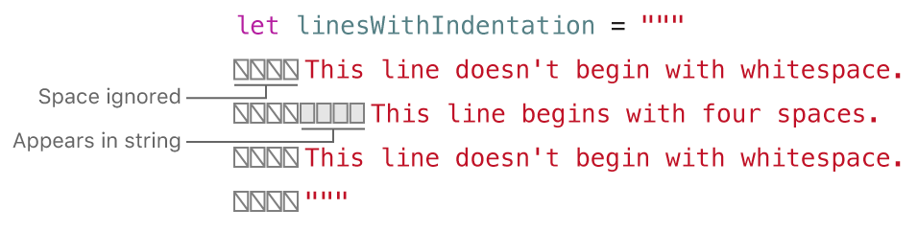

Slide 49
Special Characters in String Literals
The escaped special characters \0 (null character), \\ (backslash), \t (horizontal tab), \n (line feed), \r (carriage return), \" (double quotation mark) and \' (single quotation mark)
An arbitrary Unicode scalar, written as \u{n}, where n is a 1–8 digit hexadecimal number with a value equal to a valid Unicode code point
let wiseWords = "\"Imagination is more important than knowledge\" - Einstein" // "Imagination is more important than knowledge" - Einstein let dollarSign = "\u{24}" // $, Unicode scalar U+0024 let blackHeart = "\u{2665}" // ♥, Unicode scalar U+2665 let sparklingHeart = "\u{1F496}" // 💖, Unicode scalar U+1F496

Slide 50
let threeDoubleQuotationMarks = """ Escaping the first quotation mark \""" Escaping all three quotation marks \"\"\"
"""
//"Escaping the first quotation mark """\nEscaping all three quotation marks """"

Slide 51
Initializing an Empty String
var emptyString = "" // empty string literal
var anotherEmptyString = String() // initializer syntax
// these two strings are both empty, and are equivalent to each other
if emptyString.isEmpty { print("Nothing to see here") } // Prints "Nothing to see here"

Slide 52
String Mutability
var variableString = "Horse" variableString += " and carriage" // variableString is now "Horse and carriage" let constantString = "Highlander" constantString += " and another Highlander" // this reports a compile-time error - a constant string cannot be modified
Notes:
NOTE
This approach is different from string mutation in Objective-C and Cocoa, where you choose between two classes (NSString and NSMutableString) to indicate whether a string can be mutated.

Slide 53
Strings Are Value Types
Swift’s String type is a value type. If you create a new String value, that String value is copied when it’s passed to a function or method, or when it’s assigned to a constant or variable.

Slide 54
Working with Characters
for character in "Dog!🐶" { print(character) } // D // o // g // ! // 🐶
let catCharacters: [Character] = ["C", "a", "t", "!", "🐱"] let catString = String(catCharacters) print(catString) // Prints "Cat!🐱"

Slide 55
Concatenating Strings and Characters
addition operator (+)
let string1 = "hello" let string2 = " there" var welcome = string1 + string2 // welcome now equals "hello there"
var instruction = "look over" instruction += string2 // instruction now equals "look over there"
let exclamationMark: Character = "!" welcome.append(exclamationMark) // welcome now equals "hello there!"
Notes:
NOTE
You can’t append a String or Character to an existing Character variable, because a Charactervalue must contain a single character only.

Slide 56
String Interpolation
\()
let multiplier = 3 let message = "\(multiplier) times 2.5 is \(Double(multiplier) * 2.5)" // message is "3 times 2.5 is 7.5"
Notes:
NOTE
The expressions you write inside parentheses within an interpolated string can’t contain an unescaped backslash (\), a carriage return, or a line feed. However, they can contain other string literals.

Slide 57
Unicode
Behind the scenes, Swift’s native String type is built from Unicode scalar values. A Unicode scalar is a unique 21-bit number for a character or modifier, such as U+0061 for LATIN SMALL LETTER A ("a"), or U+1F425 for FRONT-FACING BABY CHICK ("🐥").
Notes:
NOTE
A Unicode scalar is any Unicode code point in the range U+0000 to U+D7FF inclusive or U+E000 to U+10FFFF inclusive. Unicode scalars don’t include the Unicode surrogate pair code points, which are the code points in the range U+D800 to U+DFFF inclusive.

Slide 58
Extended Grapheme Clusters
let eAcute: Character = "\u{E9}" // é let combinedEAcute: Character = "\u{65}\u{301}" // e followed by ́ // eAcute is é, combinedEAcute is é
let precomposed: Character = "\u{D55C}" // 한 let decomposed: Character = "\u{1112}\u{1161}\u{11AB}" // ᄒ, ᅡ, ᆫ // precomposed is 한, decomposed is 한
let enclosedEAcute: Character = "\u{E9}\u{20DD}" // enclosedEAcute is é
let regionalIndicatorForUS: Character = "\u{1F1FA}\u{1F1F8}" // regionalIndicatorForUS is 🇺🇸

Slide 59
Counting Characters
let unusualMenagerie = "Koala 🐨, Snail 🐌, Penguin 🐧, Dromedary 🐪" print("unusualMenagerie has \(unusualMenagerie.count) characters") // Prints "unusualMenagerie has 40 characters"
var word = "cafe" print("the number of characters in \(word) is \(word.count)") // Prints "the number of characters in cafe is 4" word += "\u{301}" // COMBINING ACUTE ACCENT, U+0301 print("the number of characters in \(word) is \(word.count)") // Prints "the number of characters in café is 4"
Notes:
NOTE
Extended grapheme clusters can be composed of multiple Unicode scalars. This means that different characters—and different representations of the same character—can require different amounts of memory to store. Because of this, characters in Swift don’t each take up the same amount of memory within a string’s representation. As a result, the number of characters in a string can’t be calculated without iterating through the string to determine its extended grapheme cluster boundaries. If you are working with particularly long string values, be aware that the countproperty must iterate over the Unicode scalars in the entire string in order to determine the characters for that string.
The count of the characters returned by the count property isn’t always the same as the lengthproperty of an NSString that contains the same characters. The length of an NSString is based on the number of 16-bit code units within the string’s UTF-16 representation and not the number of Unicode extended grapheme clusters within the string.

Slide 60
Accessing and Modifying a String
String Indices - String.Index
let greeting = "Guten Tag!" greeting[greeting.startIndex] // G greeting[greeting.index(before: greeting.endIndex)] // ! greeting[greeting.index(after: greeting.startIndex)] // u let index = greeting.index(greeting.startIndex, offsetBy: 7) greeting[index] // a

Slide 61
greeting[greeting.endIndex] // Error greeting.index(after: greeting.endIndex) // Error
for index in greeting.indices { print("\(greeting[index]) ", terminator: "") } // Prints "G u t e n T a g ! "
Notes:
NOTE
You can use the startIndex and endIndex properties and the index(before:), index(after:), and index(_:offsetBy:) methods on any type that conforms to the Collection protocol. This includes String, as shown here, as well as collection types such as Array, Dictionary, and Set.

Slide 62
Inserting: insert(_:at:) insert(contentsOf:at:)
var welcome = "hello" welcome.insert("!", at: welcome.endIndex) // welcome now equals "hello!" welcome.insert(contentsOf: " there", at: welcome.index(before: welcome.endIndex)) // welcome now equals "hello there!"
Notes:
NOTE
You can use the insert(_:at:), insert(contentsOf:at:), remove(at:), and removeSubrange(_:) methods on any type that conforms to the RangeReplaceableCollectionprotocol. This includes String, as shown here, as well as collection types such as Array, Dictionary, and Set.

Slide 63
Removing : remove(at:) removeSubrange(_:)
welcome.remove(at: welcome.index(before: welcome.endIndex)) // welcome now equals "hello there" let range = welcome.index(welcome.endIndex, offsetBy: -6)..<welcome.endIndex welcome.removeSubrange(range) // welcome now equals "hello"
Notes:
NOTE
You can use the insert(_:at:), insert(contentsOf:at:), remove(at:), and removeSubrange(_:) methods on any type that conforms to the RangeReplaceableCollectionprotocol. This includes String, as shown here, as well as collection types such as Array, Dictionary, and Set.

Slide 64
Substrings
When you get a substring from a string—for example, using a subscript or a method like prefix(_:)—the result is an instance of Substring, not another string.
unlike strings, you use substrings for only a short amount of time while performing actions on a string.
let greeting = "Hello, world!" let index = greeting.firstIndex(of: ",") ?? greeting.endIndex let beginning = greeting[..<index] // beginning is "Hello" // Convert the result to a String for long-term storage. let newString = String(beginning)

Slide 65
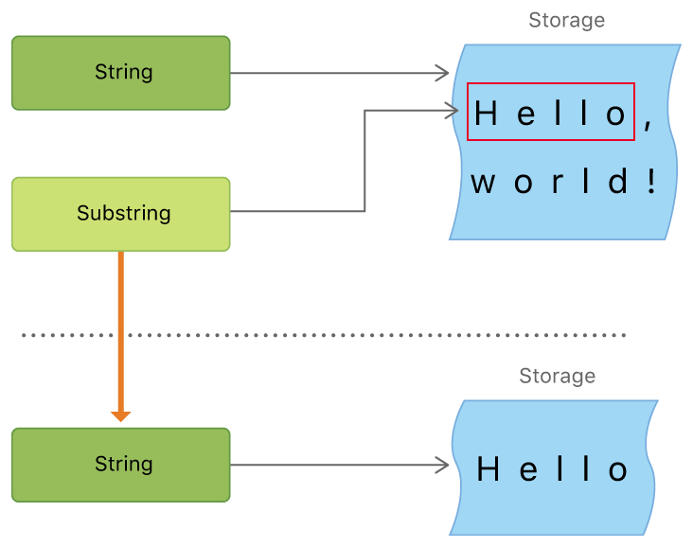
Notes:
NOTE
Both String and Substring conform to the StringProtocol protocol, which means it’s often convenient for string-manipulation functions to accept a StringProtocol value. You can call such functions with either a String or Substring value.

Slide 66
Comparing Strings
Swift provides 3 ways to compare textual values:
string and character equality
prefix equality
suffix equality
String and Character Equality
let quotation = "We're a lot alike, you and I." let sameQuotation = "We're a lot alike, you and I." if quotation == sameQuotation { print("These two strings are considered equal") } // Prints "These two strings are considered equal"

Slide 67
// "Voulez-vous un café?" using LATIN SMALL LETTER E WITH ACUTE let eAcuteQuestion = "Voulez-vous un caf\u{E9}?" // "Voulez-vous un café?" using LATIN SMALL LETTER E and COMBINING ACUTE ACCENT let combinedEAcuteQuestion = "Voulez-vous un caf\u{65}\u{301}?" if eAcuteQuestion == combinedEAcuteQuestion { print("These two strings are considered equal") } // Prints "These two strings are considered equal"

Slide 68
LATIN CAPITAL LETTER A (U+0041, or "A"), as used in English vs CYRILLIC CAPITAL LETTER A (U+0410, or "А"), as used in Russian
let latinCapitalLetterA: Character = "\u{41}" let cyrillicCapitalLetterA: Character = "\u{0410}" if latinCapitalLetterA != cyrillicCapitalLetterA { print("These two characters are not equivalent.") } // Prints "These two characters are not equivalent."
Notes:
NOTE
String and character comparisons in Swift are not locale-sensitive.

Slide 69
Prefix and Suffix Equality : hasPrefix(_:) hasSuffix(_:)
let romeoAndJuliet = [ "Act 1 Scene 1: Verona, A public place", "Act 1 Scene 2: Capulet's mansion", "Act 1 Scene 3: A room in Capulet's mansion", "Act 1 Scene 4: A street outside Capulet's mansion", "Act 1 Scene 5: The Great Hall in Capulet's mansion", "Act 2 Scene 1: Outside Capulet's mansion", "Act 2 Scene 2: Capulet's orchard", "Act 2 Scene 3: Outside Friar Lawrence's cell", "Act 2 Scene 4: A street in Verona", "Act 2 Scene 5: Capulet's mansion", "Act 2 Scene 6: Friar Lawrence's cell" ]

Slide 70
var act1SceneCount = 0 for scene in romeoAndJuliet { if scene.hasPrefix("Act 1 ") { act1SceneCount += 1 } } print("There are \(act1SceneCount) scenes in Act 1") // Prints "There are 5 scenes in Act 1"

Slide 71
var mansionCount = 0 var cellCount = 0 for scene in romeoAndJuliet { if scene.hasSuffix("Capulet's mansion") { mansionCount += 1 } else if scene.hasSuffix("Friar Lawrence's cell") { cellCount += 1 } } print("\(mansionCount) mansion scenes; \(cellCount) cell scenes") // Prints "6 mansion scenes; 2 cell scenes"
Notes:
NOTE
The hasPrefix(_:) and hasSuffix(_:) methods perform a character-by-character canonical equivalence comparison between the extended grapheme clusters in each string, as described in String and Character Equality.

Slide 72
Unicode Representations of Strings
A collection of UTF-8 code units (accessed with the string’s utf8 property)
A collection of UTF-16 code units (accessed with the string’s utf16 property)
A collection of 21-bit Unicode scalar values, equivalent to the string’s UTF-32 encoding form (accessed with the string’s unicodeScalars property)
let dogString = "Dog‼🐶"
D, o, g, !!(or Unicode scalar U+203C), 🐶(or Unicode scalar U+1F436)

Slide 73
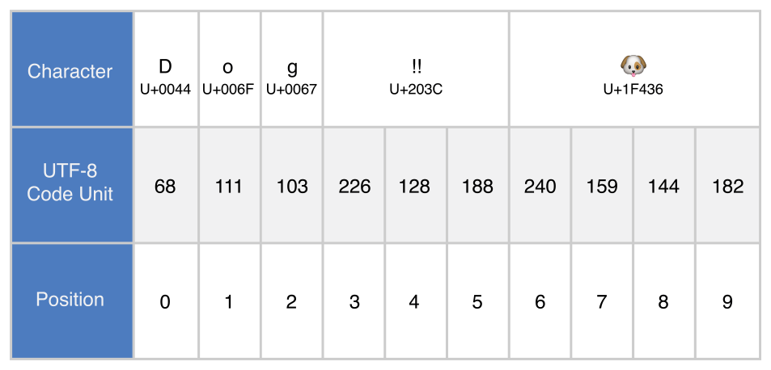
UTF-8 Representation
for codeUnit in dogString.utf8 { print("\(codeUnit) ", terminator: "") } print("") // Prints "68 111 103 226 128 188 240 159 144 182 "

Slide 74
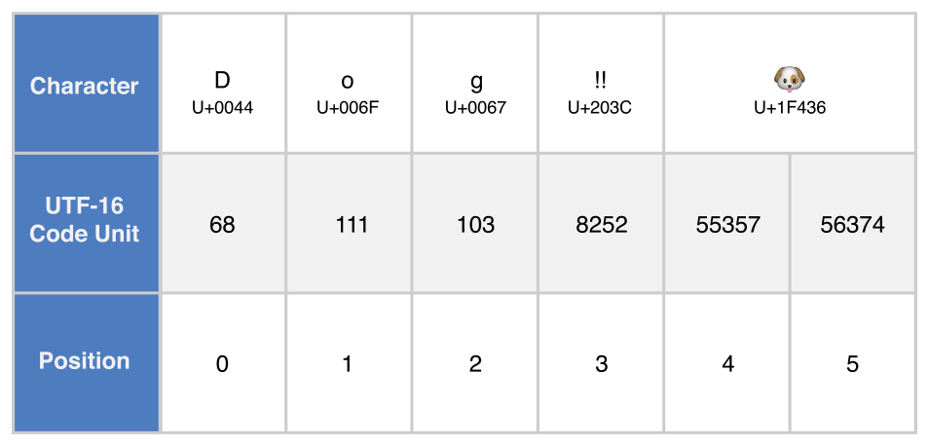
UTF-16 Representation
for codeUnit in dogString.utf16 { print("\(codeUnit) ", terminator: "") } print("") // Prints "68 111 103 8252 55357 56374 "

Slide 75
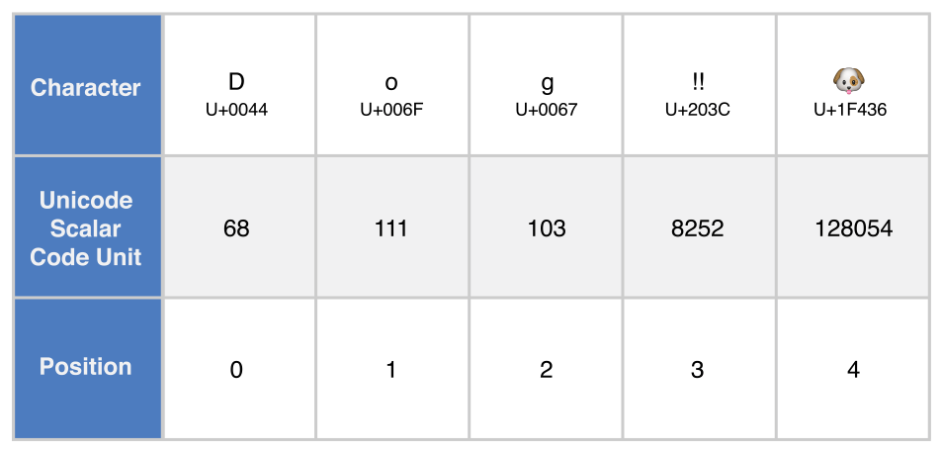
Unicode Scalar Representation
for scalar in dogString.unicodeScalars { print("\(scalar.value) ", terminator: "") } print("") // Prints "68 111 103 8252 128054
for scalar in dogString.unicodeScalars { print("\(scalar) ") } // D // o // g // ‼ // 🐶

Slide 76
Collection Types
Mutability of Collections
Arrays
Sets
Performing Set Operations
Dictionaries

Slide 77
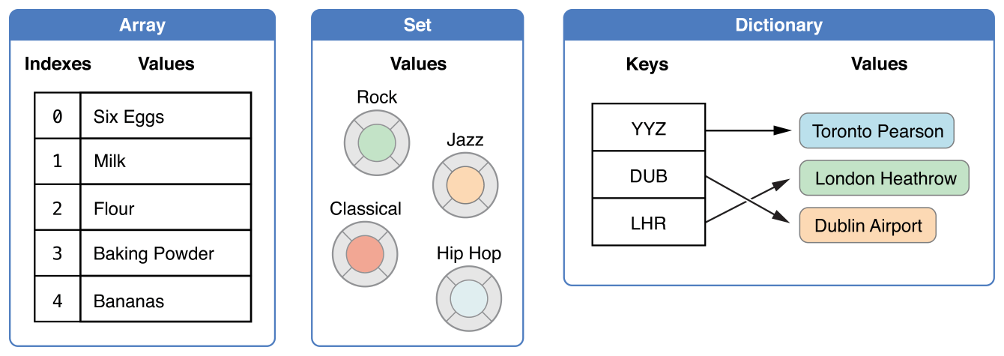
Notes:
NOTE
Swift’s array, set, and dictionary types are implemented as generic collections. For more about generic types and collections, see Generics.

Slide 78
Mutability of Collections
an array, a set, or a dictionary, and assign it to a variable, the collection that is created will be mutable
an array, a set, or a dictionary, and assign it to a constant, the collection that is created will be immutable
Notes:
NOTE
It is good practice to create immutable collections in all cases where the collection does not need to change. Doing so makes it easier for you to reason about your code and enables the Swift compiler to optimize the performance of the collections you create.

Slide 79
Arrays
An array stores values of the same type in an ordered list.
Array<Element>
Array Type Shorthand Syntax
[Element]
Notes:
NOTE
Swift’s Array type is bridged to Foundation’s NSArray class.
For more information about using Array with Foundation and Cocoa, see Bridging Between Array and NSArray.

Slide 80
Creating an Empty Array
var someInts = [Int]() print("someInts is of type [Int] with \(someInts.count) items.") // Prints "someInts is of type [Int] with 0 items."
someInts.append(3) // someInts now contains 1 value of type Int someInts = [] // someInts is now an empty array, but is still of type [Int]

Slide 81
Creating an Array with a Default Value
var threeDoubles = Array(repeating: 0.0, count: 3) // threeDoubles is of type [Double], and equals [0.0, 0.0, 0.0]

Slide 82
Creating an Array by Adding Two Arrays Together
var anotherThreeDoubles = Array(repeating: 2.5, count: 3) // anotherThreeDoubles is of type [Double], and equals [2.5, 2.5, 2.5] var sixDoubles = threeDoubles + anotherThreeDoubles // sixDoubles is inferred as [Double], and equals [0.0, 0.0, 0.0, 2.5, 2.5, 2.5]

Slide 83
Creating an Array with an Array Literal : [value 1, value 2, value 3]
var shoppingList: [String] = ["Eggs", "Milk"] // shoppingList has been initialized with two initial items
Notes:
NOTE
The shoppingList array is declared as a variable (with the var introducer) and not a constant (with the let introducer) because more items are added to the shopping list in the examples below.

Slide 84
Accessing and Modifying an Array
print("The shopping list contains \(shoppingList.count) items.") // Prints "The shopping list contains 2 items."
if shoppingList.isEmpty { print("The shopping list is empty.") } else { print("The shopping list is not empty.") } // Prints "The shopping list is not empty."

Slide 85
append(_:)
+=
shoppingList.append("Flour") // shoppingList now contains 3 items, and someone is making pancakes
shoppingList += ["Baking Powder"] // shoppingList now contains 4 items shoppingList += ["Chocolate Spread", "Cheese", "Butter"] // shoppingList now contains 7 items

Slide 86
Retrieve a value from the array by using subscript syntax
var firstItem = shoppingList[0] // firstItem is equal to "Eggs"
Modify
shoppingList[0] = "Six eggs" // the first item in the list is now equal to "Six eggs" rather than "Eggs"
Notes:
NOTE
The first item in the array has an index of 0, not 1. Arrays in Swift are always zero-indexed.

Slide 87
Modify in Range
shoppingList[4...6] = ["Bananas", "Apples"] // shoppingList now contains 6 items
Insert at a specified index : insert(_:at:)
shoppingList.insert("Maple Syrup", at: 0) // shoppingList now contains 7 items // "Maple Syrup" is now the first item in the list

Slide 88
Remove at a specified index: remove(at:)
let mapleSyrup = shoppingList.remove(at: 0) // the item that was at index 0 has just been removed // shoppingList now contains 6 items, and no Maple Syrup // the mapleSyrup constant is now equal to the removed "Maple Syrup" string
firstItem = shoppingList[0]
// firstItem is now equal to "Six eggs"
remove the final item: removeLast()
let apples = shoppingList.removeLast() // the last item in the array has just been removed // shoppingList now contains 5 items, and no apples // the apples constant is now equal to the removed "Apples" string
Notes:
NOTE
If you try to access or modify a value for an index that is outside of an array’s existing bounds, you will trigger a runtime error. You can check that an index is valid before using it by comparing it to the array’s count property. The largest valid index in an array is count - 1 because arrays are indexed from zero—however, when count is 0 (meaning the array is empty), there are no valid indexes.

Slide 89
Iterating Over an Array
for item in shoppingList { print(item) } // Six eggs // Milk // Flour // Baking Powder // Bananas

Slide 90
If you need the integer index of each item as well as its value, use the enumerated()
for (index, value) in shoppingList.enumerated() { print("Item \(index + 1): \(value)") } // Item 1: Six eggs // Item 2: Milk // Item 3: Flour // Item 4: Baking Powder // Item 5: Bananas

Slide 91
Sets
A set stores distinct values of the same type in a collection with no defined ordering.
Hash Values for Set Types
A type must be hashable in order to be stored in a set—that is, the type must provide a way to compute a hash value for itself.
All of Swift’s basic types (such as String, Int, Double, and Bool) are hashable by default, and can be used as set value types or dictionary key types. Enumeration case values without associated values (as described in Enumerations) are also hashable by default.
Notes:
NOTE
Swift’s Set type is bridged to Foundation’s NSSet class.
For more information about using Set with Foundation and Cocoa, see Bridging Between Set and NSSet.
NOTE
You can use your own custom types as set value types or dictionary key types by making them conform to the Hashable protocol from Swift’s standard library. Types that conform to the Hashable protocol must provide a gettable Int property called hashValue. The value returned by a type’s hashValue property is not required to be the same across different executions of the same program, or in different programs.
Because the Hashable protocol conforms to Equatable, conforming types must also provide an implementation of the equals operator (==). The Equatable protocol requires any conforming implementation of == to be an equivalence relation. That is, an implementation of == must satisfy the following three conditions, for all values a, b, and c:
a == a (Reflexivity)
a == b implies b == a (Symmetry)
a == b && b == c implies a == c (Transitivity)
For more information about conforming to protocols, see Protocols.

Slide 92
Set Type Syntax
Set<Element>

Slide 93
Creating and Initializing an Empty Set
var letters = Set<Character>() print("letters is of type Set<Character> with \(letters.count) items.") // Prints "letters is of type Set<Character> with 0 items."
letters.insert("a") // letters now contains 1 value of type Character letters = [] // letters is now an empty set, but is still of type Set<Character>
Notes:
NOTE
The type of the letters variable is inferred to be Set<Character>, from the type of the initializer.

Slide 94
Creating a Set with an Array Literal
var favoriteGenres: Set<String> = ["Rock", "Classical", "Hip hop"] // favoriteGenres has been initialized with three initial items
var favoriteGenres: Set = ["Rock", "Classical", "Hip hop"]
Notes:
NOTE
The favoriteGenres set is declared as a variable (with the var introducer) and not a constant (with the let introducer) because items are added and removed in the examples below.

Slide 95
Accessing and Modifying a Set
print("I have \(favoriteGenres.count) favorite music genres.") // Prints "I have 3 favorite music genres."
if favoriteGenres.isEmpty { print("As far as music goes, I'm not picky.") } else { print("I have particular music preferences.") } // Prints "I have particular music preferences."

Slide 96
insert(_:), remove(_:)
favoriteGenres.insert("Jazz") // favoriteGenres now contains 4 items
if let removedGenre = favoriteGenres.remove("Rock") { print("\(removedGenre)? I'm over it.") } else { print("I never much cared for that.") } // Prints "Rock? I'm over it."

Slide 97
contains(_:)
if favoriteGenres.contains("Funk") { print("I get up on the good foot.") } else { print("It's too funky in here.") } // Prints "It's too funky in here."

Slide 98
Iterating Over a Set
for genre in favoriteGenres { print("\(genre)") } // Classical // Jazz // Hip hop
for genre in favoriteGenres.sorted() { print("\(genre)") } // Classical // Hip hop // Jazz

Slide 99
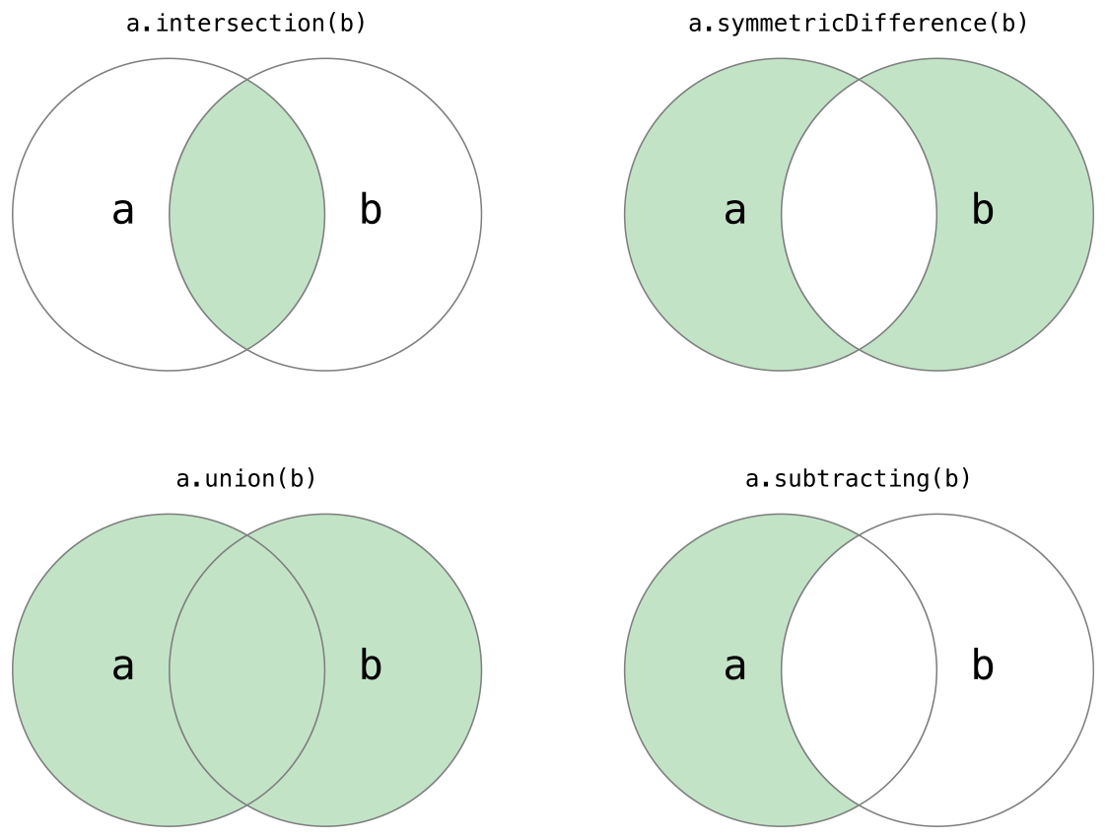
Performing Set Operations
Fundamental Set Operations

Slide 100
Fundamental Set Operations
let oddDigits: Set = [1, 3, 5, 7, 9] let evenDigits: Set = [0, 2, 4, 6, 8] let singleDigitPrimeNumbers: Set = [2, 3, 5, 7] oddDigits.union(evenDigits).sorted() // [0, 1, 2, 3, 4, 5, 6, 7, 8, 9] oddDigits.intersection(evenDigits).sorted() // [] oddDigits.subtracting(singleDigitPrimeNumbers).sorted() // [1, 9] oddDigits.symmetricDifference(singleDigitPrimeNumbers).sorted() // [1, 2, 9]

Slide 101
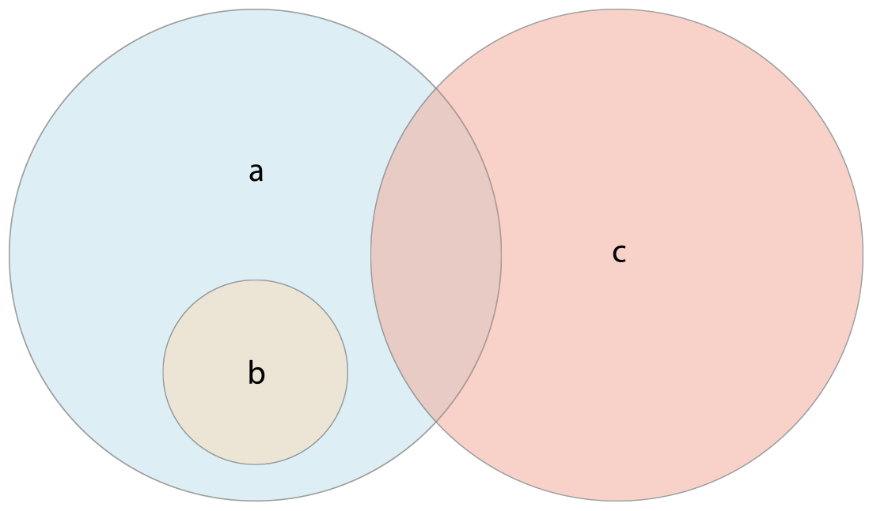
Set Membership and Equality
Use the “is equal” operator (==) to determine whether two sets contain all of the same values.
Use the isSubset(of:) method to determine whether all of the values of a set are contained in the specified set.
Use the isSuperset(of:) method to determine whether a set contains all of the values in a specified set.
Use the isStrictSubset(of:) or isStrictSuperset(of:) methods to determine whether a set is a subset or superset, but not equal to, a specified set.
Use the isDisjoint(with:) method to determine whether two sets have no values in common.

Slide 102
Set Membership and Equality
let houseAnimals: Set = ["🐶", "🐱"] let farmAnimals: Set = ["🐮", "🐔", "🐑", "🐶", "🐱"] let cityAnimals: Set = ["🐦", "🐭"] houseAnimals.isSubset(of: farmAnimals) // true farmAnimals.isSuperset(of: houseAnimals) // true farmAnimals.isDisjoint(with: cityAnimals) // true

Slide 103
Dictionaries
A dictionary stores associations between keys of the same type and values of the same type in a collection with no defined ordering.
Dictionary<Key, Value>
Dictionary Type Shorthand Syntax
[Key: Value]
Notes:
NOTE
Swift’s Dictionary type is bridged to Foundation’s NSDictionary class.
NOTE
A dictionary Key type must conform to the Hashable protocol, like a set’s value type.
For more information about using Dictionary with Foundation and Cocoa, see Bridging Between Dictionary and NSDictionary. NOTE
A dictionary Key type must conform to the Hashable protocol, like a set’s value type.

Slide 104
Creating an Empty Dictionary
var namesOfIntegers = [Int: String]() // namesOfIntegers is an empty [Int: String] dictionary
namesOfIntegers[16] = "sixteen" // namesOfIntegers now contains 1 key-value pair namesOfIntegers = [:] // namesOfIntegers is once again an empty dictionary of type [Int: String]

Slide 105
Creating a Dictionary with a Dictionary Literal - [key 1: value 1, key 2: value 2, key 3: value 3]
var airports: [String: String] = ["YYZ": "Toronto Pearson", "DUB": "Dublin"]
var airports = ["YYZ": "Toronto Pearson", "DUB": "Dublin"]
Notes:
NOTE
The airports dictionary is declared as a variable (with the var introducer), and not a constant (with the let introducer), because more airports are added to the dictionary in the examples below.

Slide 106
Accessing and Modifying a Dictionary
print("The airports dictionary contains \(airports.count) items.") // Prints "The airports dictionary contains 2 items."
if airports.isEmpty { print("The airports dictionary is empty.") } else { print("The airports dictionary is not empty.") } // Prints "The airports dictionary is not empty."
Notes:
NOTE
Swift’s Dictionary type is bridged to Foundation’s NSDictionary class.
For more information about using Dictionary with Foundation and Cocoa, see Bridging Between Dictionary and NSDictionary. NOTE
A dictionary Key type must conform to the Hashable protocol, like a set’s value type.

Slide 107
airports["LHR"] = "London" // the airports dictionary now contains 3 items
airports["LHR"] = "London Heathrow" // the value for "LHR" has been changed to "London Heathrow"
if let oldValue = airports.updateValue("Dublin Airport", forKey: "DUB") { print("The old value for DUB was \(oldValue).") } // Prints "The old value for DUB was Dublin."
Notes:
NOTE
Swift’s Dictionary type is bridged to Foundation’s NSDictionary class.
For more information about using Dictionary with Foundation and Cocoa, see Bridging Between Dictionary and NSDictionary. NOTE
A dictionary Key type must conform to the Hashable protocol, like a set’s value type.

Slide 108
if let airportName = airports["DUB"] { print("The name of the airport is \(airportName).") } else { print("That airport is not in the airports dictionary.") } // Prints "The name of the airport is Dublin Airport."
Notes:
NOTE
Swift’s Dictionary type is bridged to Foundation’s NSDictionary class.
For more information about using Dictionary with Foundation and Cocoa, see Bridging Between Dictionary and NSDictionary. NOTE
A dictionary Key type must conform to the Hashable protocol, like a set’s value type.

Slide 109
airports["APL"] = "Apple International" // "Apple International" is not the real airport for APL, so delete it airports["APL"] = nil // APL has now been removed from the dictionary
if let removedValue = airports.removeValue(forKey: "DUB") { print("The removed airport's name is \(removedValue).") } else { print("The airports dictionary does not contain a value for DUB.") } // Prints "The removed airport's name is Dublin Airport."
Notes:
NOTE
Swift’s Dictionary type is bridged to Foundation’s NSDictionary class.
For more information about using Dictionary with Foundation and Cocoa, see Bridging Between Dictionary and NSDictionary. NOTE
A dictionary Key type must conform to the Hashable protocol, like a set’s value type.

Slide 110
Iterating Over a Dictionary
for (airportCode, airportName) in airports { print("\(airportCode): \(airportName)") } // YYZ: Toronto Pearson // LHR: London Heathrow
Notes:
NOTE
Swift’s Dictionary type is bridged to Foundation’s NSDictionary class.
For more information about using Dictionary with Foundation and Cocoa, see Bridging Between Dictionary and NSDictionary. NOTE
A dictionary Key type must conform to the Hashable protocol, like a set’s value type.

Slide 111
for airportCode in airports.keys { print("Airport code: \(airportCode)") } // Airport code: YYZ // Airport code: LHR for airportName in airports.values { print("Airport name: \(airportName)") } // Airport name: Toronto Pearson // Airport name: London Heathrow
Notes:
NOTE
Swift’s Dictionary type is bridged to Foundation’s NSDictionary class.
For more information about using Dictionary with Foundation and Cocoa, see Bridging Between Dictionary and NSDictionary. NOTE
A dictionary Key type must conform to the Hashable protocol, like a set’s value type.

Slide 112
let airportCodes = [String](airports.keys) // airportCodes is ["YYZ", "LHR"] let airportNames = [String](airports.values) // airportNames is ["Toronto Pearson", "London Heathrow"]
Notes:
NOTE
Swift’s Dictionary type is bridged to Foundation’s NSDictionary class.
For more information about using Dictionary with Foundation and Cocoa, see Bridging Between Dictionary and NSDictionary. NOTE
A dictionary Key type must conform to the Hashable protocol, like a set’s value type.

Slide 113
Control Flow - I
For-In Loops
While Loops
Conditional Statements
If
Switch
No Implicit Fallthrough
Interval Matching
Tuples
Value Bindings
Where
Compound Cases

Slide 114
Control Flow - II
Control Transfer Statements
Continue
Break
Fallthrough
Labeled Statements
Early Exit
Checking API Availability

Slide 115
For-In Loops
let names = ["Anna", "Alex", "Brian", "Jack"] for name in names { print("Hello, \(name)!") } // Hello, Anna! // Hello, Alex! // Hello, Brian! // Hello, Jack!

Slide 116
let numberOfLegs = ["spider": 8, "ant": 6, "cat": 4] for (animalName, legCount) in numberOfLegs { print("\(animalName)s have \(legCount) legs") } // ants have 6 legs // cats have 4 legs // spiders have 8 legs

Slide 117
for index in 1...5 { print("\(index) times 5 is \(index * 5)") } // 1 times 5 is 5 // 2 times 5 is 10 // 3 times 5 is 15 // 4 times 5 is 20 // 5 times 5 is 25

Slide 118
let base = 3 let power = 10 var answer = 1 for _ in 1...power { answer *= base } print("\(base) to the power of \(power) is \(answer)") // Prints "3 to the power of 10 is 59049"

Slide 119
let minutes = 60 for tickMark in 0..<minutes { // render the tick mark each minute (60 times) }
stride(from:to:by:)
let minuteInterval = 5 for tickMark in stride(from: 0, to: minutes, by: minuteInterval) { // render the tick mark every 5 minutes (0, 5, 10, 15 ... 45, 50, 55) }

Slide 120
stride(from:thorugh:by:)
let hours = 12 let hourInterval = 3 for tickMark in stride(from: 3, through: hours, by: hourInterval) { // render the tick mark every 3 hours (3, 6, 9, 12) }

Slide 121
While Loops
While
while condition { statements }
Notes:
NOTE
If this check is not performed, board[square] might try to access a value outside the bounds of the board array, which would trigger a runtime error.

Slide 122
While Loops
Repeat-While
repeat { statements } while condition
Notes:
NOTE
The repeat-while loop in Swift is analogous to a do-while loop in other languages.

Slide 123
Conditional Statements
If
var temperatureInFahrenheit = 30 if temperatureInFahrenheit <= 32 { print("It's very cold. Consider wearing a scarf.") } // Prints "It's very cold. Consider wearing a scarf."

Slide 124
Switch
switch some value to consider { case value 1: respond to value 1 case value 2, value 3: respond to value 2 or 3 default: otherwise, do something else }

Slide 125
No Implicit Fallthrough
let anotherCharacter: Character = "a" switch anotherCharacter { case "a": // Invalid, the case has an empty body case "A": print("The letter A") default: print("Not the letter A") } // This will report a compile-time error.
Notes:
NOTE
Although break is not required in Swift, you can use a break statement to match and ignore a particular case or to break out of a matched case before that case has completed its execution. For details, see Break in a Switch Statement.

Slide 126
let anotherCharacter: Character = "a" switch anotherCharacter { case "a", "A": print("The letter A") default: print("Not the letter A") } // Prints "The letter A"
Notes:
NOTE
Although break is not required in Swift, you can use a break statement to match and ignore a particular case or to break out of a matched case before that case has completed its execution. For details, see Break in a Switch Statement.

Slide 127
Interval Matching
let approximateCount = 62 let countedThings = "moons orbiting Saturn" let naturalCount: String switch approximateCount { case 0: naturalCount = "no" case 1..<5: naturalCount = "a few" case 5..<12: naturalCount = "several" case 12..<100: naturalCount = "dozens of" case 100..<1000: naturalCount = "hundreds of" default: naturalCount = "many" } print("There are \(naturalCount) \(countedThings).") // Prints "There are dozens of moons orbiting Saturn."

Slide 128
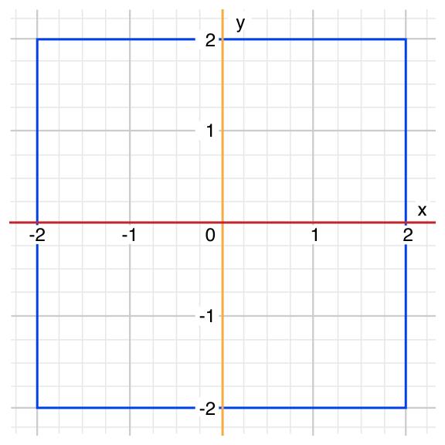
Tuples
let somePoint = (1, 1) switch somePoint { case (0, 0): print("\(somePoint) is at the origin") case (_, 0): print("\(somePoint) is on the x-axis") case (0, _): print("\(somePoint) is on the y-axis") case (-2...2, -2...2): print("\(somePoint) is inside the box") default: print("\(somePoint) is outside of the box") } // Prints "(1, 1) is inside the box"

Slide 129
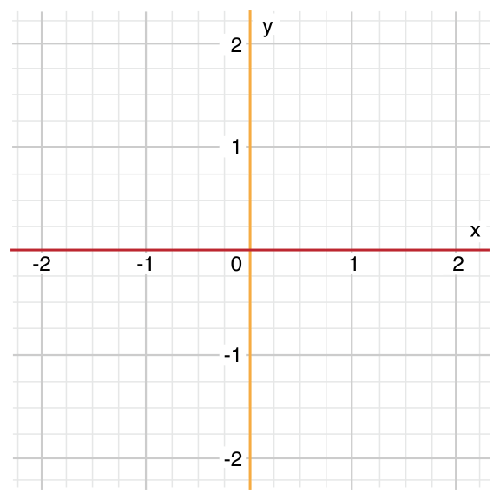
Value Bindings
let anotherPoint = (2, 0) switch anotherPoint { case (let x, 0): print("on the x-axis with an x value of \(x)") case (0, let y): print("on the y-axis with a y value of \(y)") case let (x, y): print("somewhere else at (\(x), \(y))") } // Prints "on the x-axis with an x value of 2"

Slide 130
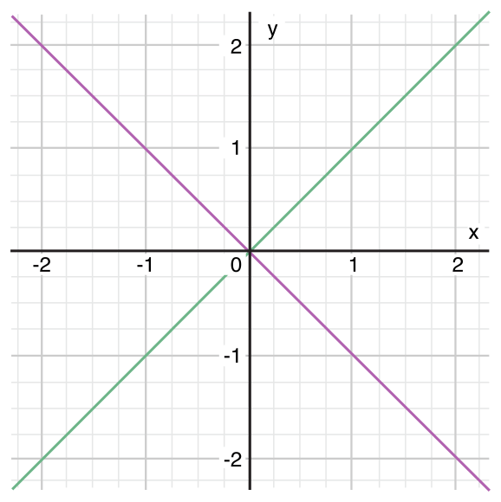
Where
let yetAnotherPoint = (1, -1) switch yetAnotherPoint { case let (x, y) where x == y: print("(\(x), \(y)) is on the line x == y") case let (x, y) where x == -y:v print("(\(x), \(y)) is on the line x == -y") case let (x, y): print("(\(x), \(y)) is just some arbitrary point") } // Prints "(1, -1) is on the line x == -y"

Slide 131
Compound Cases
let someCharacter: Character = "e" switch someCharacter { case "a", "e", "i", "o", "u": print("\(someCharacter) is a vowel") case "b", "c", "d", "f", "g", "h", "j", "k", "l", "m", "n", "p", "q", "r", "s", "t", "v", "w", "x", "y", "z": print("\(someCharacter) is a consonant") default: print("\(someCharacter) is not a vowel or a consonant") } // Prints "e is a vowel"

Slide 132
Compound Cases with value bindings
let stillAnotherPoint = (9, 0) switch stillAnotherPoint { case (let distance, 0), (0, let distance): print("On an axis, \(distance) from the origin") default: print("Not on an axis") } // Prints "On an axis, 9 from the origin"

Slide 133
Conditional Transfer Statements
continue
break
fallthrough
return
throw

Slide 134
Continue
let puzzleInput = "great minds think alike" var puzzleOutput = "" let charactersToRemove: [Character] = ["a", "e", "i", "o", "u", " "] for character in puzzleInput { if charactersToRemove.contains(character) { continue } else { puzzleOutput.append(character) } } print(puzzleOutput) // Prints "grtmndsthnklk"

Slide 135
Break
Break in a Loop Statement
Break in a Switch Statement
Notes:
NOTE
A switch case that contains only a comment is reported as a compile-time error. Comments are not statements and do not cause a switch case to be ignored. Always use a break statement to ignore a switch case.

Slide 136
let numberSymbol: Character = "三" // Chinese symbol for the number 3 var possibleIntegerValue: Int? switch numberSymbol { case "1", "١", "一", "๑": possibleIntegerValue = 1 case "2", "٢", "二", "๒": possibleIntegerValue = 2 case "3", "٣", "三", "๓": possibleIntegerValue = 3 case "4", "٤", "四", "๔": possibleIntegerValue = 4 default: break } if let integerValue = possibleIntegerValue { print("The integer value of \(numberSymbol) is \(integerValue).") } else { print("An integer value could not be found for \(numberSymbol).") } // Prints "The integer value of 三 is 3."

Slide 137
Fallthrough
let integerToDescribe = 5 var description = "The number \(integerToDescribe) is" switch integerToDescribe { case 2, 3, 5, 7, 11, 13, 17, 19: description += " a prime number, and also" fallthrough default: description += " an integer." } print(description) // Prints "The number 5 is a prime number, and also an integer."
Notes:
NOTE
The fallthrough keyword does not check the case conditions for the switch case that it causes execution to fall into. The fallthrough keyword simply causes code execution to move directly to the statements inside the next case (or default case) block, as in C’s standard switch statement behavior.

Slide 138
Labeled Statements
label name: while condition { statements }
Notes:
NOTE
If the break statement above did not use the gameLoop label, it would break out of the switchstatement, not the while statement. Using the gameLoop label makes it clear which control statement should be terminated.
It is not strictly necessary to use the gameLoop label when calling continue gameLoop to jump to the next iteration of the loop. There is only one loop in the game, and therefore no ambiguity as to which loop the continue statement will affect. However, there is no harm in using the gameLooplabel with the continue statement. Doing so is consistent with the label’s use alongside the breakstatement and helps make the game’s logic clearer to read and understand.

Slide 139
gameLoop: while square != finalSquare { diceRoll += 1 if diceRoll == 7 { diceRoll = 1 } switch square + diceRoll { case finalSquare: // diceRoll will move us to the final square, so the game is over break gameLoop case let newSquare where newSquare > finalSquare: // diceRoll will move us beyond the final square, so roll again continue gameLoop default: // this is a valid move, so find out its effect square += diceRoll square += board[square] } } print("Game over!")
Notes:
Here’s an example of this syntax for a while loop, although the principle is the same for all loops and switch statements:

Slide 140
Early Exit
guard
func greet(person: [String: String]) { guard let name = person["name"] else { return } print("Hello \(name)!") guard let location = person["location"] else { print("I hope the weather is nice near you.") return } print("I hope the weather is nice in \(location).") }

Slide 141
greet(person: ["name": "John"]) // Prints "Hello John!" // Prints "I hope the weather is nice near you." greet(person: ["name": "Jane", "location": "Cupertino"]) // Prints "Hello Jane!" // Prints "I hope the weather is nice in Cupertino."

Slide 142
Checking API Availability
if #available(iOS 10, macOS 10.12, *) { // Use iOS 10 APIs on iOS, and use macOS 10.12 APIs on macOS } else { // Fall back to earlier iOS and macOS APIs }

Slide 143
Functions
Defining and Calling Functions
Function Parameters and Return Values
Functions Without Parameters
Functions With Multiple Parameters Functions Without Return Values
Functions With Multiple Return Values
Optional Tuple Return Types
Function Argument Labels and Parameter Names
Specifying Argument Labels
Omitting Argument Labels
Default Parameter Values
Variadic Parameters
In-Out Parameters
Function Types
Nested Functions

Slide 144
Defining and Calling Functions
func greet(person: String) -> String { let greeting = "Hello, " + person + "!" return greeting }
print(greet(person: "Anna")) // Prints "Hello, Anna!"
print(greet(person: "Brian")) // Prints "Hello, Brian!"
Notes:
NOTE
The print(_:separator:terminator:) function doesn’t have a label for its first argument, and its other arguments are optional because they have a default value. These variations on function syntax are discussed below in Function Argument Labels and Parameter Names and Default Parameter Values.

Slide 145
Function Parameters and Return Values
Functions Without Parameters
func sayHelloWorld() -> String { return "hello, world" } print(sayHelloWorld()) // Prints "hello, world"
func greetAgain(person: String) -> String { return "Hello again, " + person + "!" } print(greetAgain(person: "Anna")) // Prints "Hello again, Anna!"

Slide 146
Functions With Multiple Parameters
func greet(person: String, alreadyGreeted: Bool) -> String { if alreadyGreeted { return greetAgain(person: person) } else { return greet(person: person) } } print(greet(person: "Tim", alreadyGreeted: true)) // Prints "Hello again, Tim!"

Slide 147
Functions Without Return Values
func greet(person: String) { print("Hello, \(person)!") } greet(person: "Dave") // Prints "Hello, Dave!"
Notes:
NOTE
Strictly speaking, this version of the greet(person:) function does still return a value, even though no return value is defined. Functions without a defined return type return a special value of type Void. This is simply an empty tuple, which is written as ().

Slide 148
func printAndCount(string: String) -> Int { print(string) return string.count } func printWithoutCounting(string: String) { let _ = printAndCount(string: string) } printAndCount(string: "hello, world") // prints "hello, world" and returns a value of 12 printWithoutCounting(string: "hello, world") // prints "hello, world" but does not return a value

Slide 149
Functions with Multiple Return Values ; Tuple
func minMax(array: [Int]) -> (min: Int, max: Int) { var currentMin = array[0] var currentMax = array[0] for value in array[1..<array.count] { if value < currentMin { currentMin = value } else if value > currentMax { currentMax = value } } return (currentMin, currentMax) }
let bounds = minMax(array: [8, -6, 2, 109, 3, 71]) print("min is \(bounds.min) and max is \(bounds.max)") // Prints "min is -6 and max is 109"

Slide 150
Optional Tuple Return Types
func minMax(array: [Int]) -> (min: Int, max: Int)? { if array.isEmpty { return nil } var currentMin = array[0] var currentMax = array[0] for value in array[1..<array.count] { if value < currentMin { currentMin = value } else if value > currentMax { currentMax = value } } return (currentMin, currentMax) }
if let bounds = minMax(array: [8, -6, 2, 109, 3, 71]) { print("min is \(bounds.min) and max is \(bounds.max)") } // Prints "min is -6 and max is 109"
Notes:
NOTE
An optional tuple type such as (Int, Int)? is different from a tuple that contains optional types such as (Int?, Int?). With an optional tuple type, the entire tuple is optional, not just each individual value within the tuple.

Slide 151
Function Argument Labels and Parameter Name
argument label
parameter name
By default, parameters use their parameter name as their argument label.
func someFunction(firstParameterName: Int, secondParameterName: Int) { // In the function body, firstParameterName and secondParameterName // refer to the argument values for the first and second parameters. } someFunction(firstParameterName: 1, secondParameterName: 2)

Slide 152
Specifying Argument Labels
func someFunction(argumentLabel parameterName: Int) { // In the function body, parameterName refers to the argument value // for that parameter. }
func greet(person: String, from hometown: String) -> String { return "Hello \(person)! Glad you could visit from \(hometown)." } print(greet(person: "Bill", from: "Cupertino")) // Prints "Hello Bill! Glad you could visit from Cupertino."

Slide 153
Omitting Argument Labels
func someFunction(_ firstParameterName: Int, secondParameterName: Int) { // In the function body, firstParameterName and secondParameterName // refer to the argument values for the first and second parameters. } someFunction(1, secondParameterName: 2)

Slide 154
Default Parameter Values
func someFunction(parameterWithoutDefault: Int, parameterWithDefault: Int = 12) { // If you omit the second argument when calling this function, then // the value of parameterWithDefault is 12 inside the function body. } someFunction(parameterWithoutDefault: 3, parameterWithDefault: 6) // parameterWithDefault is 6 someFunction(parameterWithoutDefault: 4) // parameterWithDefault is 12

Slide 155
Variadic Parameters
func arithmeticMean(_ numbers: Double...) -> Double { var total: Double = 0 for number in numbers { total += number } return total / Double(numbers.count) } arithmeticMean(1, 2, 3, 4, 5) // returns 3.0, which is the arithmetic mean of these five numbers arithmeticMean(3, 8.25, 18.75) // returns 10.0, which is the arithmetic mean of these three numbers
Notes:
NOTE
A function may have at most one variadic parameter.

Slide 156
In-Out Parameters
func swapTwoInts(_ a: inout Int, _ b: inout Int) { let temporaryA = a a = b b = temporaryA }
var someInt = 3 var anotherInt = 107 swapTwoInts(&someInt, &anotherInt) print("someInt is now \(someInt), and anotherInt is now \(anotherInt)") // Prints "someInt is now 107, and anotherInt is now 3"
Notes:
NOTE
In-out parameters cannot have default values, and variadic parameters cannot be marked as inout.
NOTE
In-out parameters are not the same as returning a value from a function. The swapTwoIntsexample above does not define a return type or return a value, but it still modifies the values of someInt and anotherInt. In-out parameters are an alternative way for a function to have an effect outside of the scope of its function body.

Slide 157
Function Types
Every function has a specific function type, made up of the parameter types and the return type of the function.
(Int, Int) -> Int
func addTwoInts(_ a: Int, _ b: Int) -> Int { return a + b } func multiplyTwoInts(_ a: Int, _ b: Int) -> Int { return a * b }
() -> Void
func printHelloWorld() { print("hello, world") }

Slide 158
Using Function Types
var mathFunction: (Int, Int) -> Int = addTwoInts
print("Result: \(mathFunction(2, 3))") // Prints "Result: 5"
mathFunction = multiplyTwoInts print("Result: \(mathFunction(2, 3))") // Prints "Result: 6"
let anotherMathFunction = addTwoInts // anotherMathFunction is inferred to be of type (Int, Int) -> Int

Slide 159
Function Types as Parameter Types
func printMathResult(_ mathFunction: (Int, Int) -> Int, _ a: Int, _ b: Int) { print("Result: \(mathFunction(a, b))") } printMathResult(addTwoInts, 3, 5) // Prints "Result: 8"
Notes:
This example defines a function called printMathResult(_:_:_:), which has three parameters. The first parameter is called mathFunction, and is of type (Int, Int) -> Int. You can pass any function of that type as the argument for this first parameter. The second and third parameters are called a and b, and are both of type Int. These are used as the two input values for the provided math function.

Slide 160
Function Types as Return Types
func stepForward(_ input: Int) -> Int { return input + 1 } func stepBackward(_ input: Int) -> Int { return input - 1 }
func chooseStepFunction(backward: Bool) -> (Int) -> Int { return backward ? stepBackward : stepForward }
var currentValue = 3 let moveNearerToZero = chooseStepFunction(backward: currentValue > 0) // moveNearerToZero now refers to the stepBackward() function

Slide 161
print("Counting to zero:") // Counting to zero: while currentValue != 0 { print("\(currentValue)... ") currentValue = moveNearerToZero(currentValue) } print("zero!") // 3... // 2... // 1... // zero!

Slide 162
Nested Functions
func chooseStepFunction(backward: Bool) -> (Int) -> Int { func stepForward(input: Int) -> Int { return input + 1 } func stepBackward(input: Int) -> Int { return input - 1 } return backward ? stepBackward : stepForward } var currentValue = -4 let moveNearerToZero = chooseStepFunction(backward: currentValue > 0) // moveNearerToZero now refers to the nested stepForward() function while currentValue != 0 { print("\(currentValue)... ") currentValue = moveNearerToZero(currentValue) } print("zero!") // -4... // -3... // -2... // -1... // zero!
Notes:
Nested functions are hidden from the outside world by default, but can still be called and used by their enclosing function. An enclosing function can also return one of its nested functions to allow the nested function to be used in another scope.

Slide 163
Closures
Closure Expressions
Trailing Closures
Capturing Values
Closures Are Reference Types
Escaping CLosures
Autoclosures

Slide 164
Closure Expressions
The Sorted Method

Slide 165
Closure Expression Syntax

Slide 166
Inferring Type From Context

Slide 167
Implicit Returns from Single-Expression Closures

Slide 168
Shorthand Argument Names

Slide 169
Operator Methods

Slide 170
Trailing Closures

Slide 171
Capturing Values

Slide 172
Closures Are Reference Types

Slide 173
Escaping Closures

Slide 174
Autoclosures

Slide 175
Enumerations
Enumeration Syntax
Matching Enumeration Values with a Switch Statement
Iterating over Enumeration Cases
Associated Values
Raw Values
Recursive Enumerations

Slide 176
Enumeration Syntax

Slide 177
Matching Enumeration Values with a Switch Statement

Slide 178
Iterating over Enumeration Cases

Slide 179
Associated Values

Slide 180
Raw Values
Implicitly Assigned Raw Values

Slide 181
Initializing from a Raw Value

Slide 182
Recursive Enumerations

Slide 183
Structures and Classes
Comparing Structures and Classes
Structures and Enumerations Are Value Types
Classes Are Reference Types
Notes:
NOTE
An instance of a class is traditionally known as an object. However, Swift structures and classes are much closer in functionality than in other languages, and much of this chapter describes functionality that applies to instances of either a class or a structure type. Because of this, the more general term instance is used.

Slide 184
Comparing Structures and Classes
Define properties to store values
Define methods to provide functionality
Define subscripts to provide access to their values using subscript syntax
Define initializers to set up their initial state
Be extended to expand their functionality beyond a default implementation
Conform to protocols to provide standard functionality of a certain kind

Slide 185
Classes have additional capabilities that structures don’t have:
Inheritance enables one class to inherit the characteristics of another.
Type casting enables you to check and interpret the type of a class instance at runtime.
Deinitializers enable an instance of a class to free up any resources it has assigned.
Reference counting allows more than one reference to a class instance.
Notes:
The additional capabilities that classes support come at the cost of increased complexity. As a general guideline, prefer structures and enumerations because they’re easier to reason about, and use classes when they’re appropriate or necessary.

Slide 186
Definition Syntax
struct SomeStructure { // structure definition goes here } class SomeClass { // class definition goes here }
struct Resolution { var width = 0 var height = 0 } class VideoMode { var resolution = Resolution() var interlaced = false var frameRate = 0.0 var name: String? }
Notes:
NOTE
Whenever you define a new structure or class, you define a new Swift type. Give types UpperCamelCase names (such as SomeStructure and SomeClass here) to match the capitalization of standard Swift types (such as String, Int, and Bool). Give properties and methods lowerCamelCase names (such as frameRate and incrementCount) to differentiate them from type names.

Slide 187
Structure and Class Instances
let someResolution = Resolution() let someVideoMode = VideoMode()

Slide 188
Accessing Properties
print("The width of someResolution is \(someResolution.width)") // Prints "The width of someResolution is 0"
print("The width of someVideoMode is \(someVideoMode.resolution.width)") // Prints "The width of someVideoMode is 0"
someVideoMode.resolution.width = 1280 print("The width of someVideoMode is now \(someVideoMode.resolution.width)") // Prints "The width of someVideoMode is now 1280"

Slide 189
Memberwise Initializers for Structure Types
let vga = Resolution(width: 640, height: 480)

Slide 190
Structures and Enumerations Are Value Types
A value type is a type whose value is copied when it’s assigned to a variable or constant, or when it’s passed to a function.
let hd = Resolution(width: 1920, height: 1080) var cinema = hd
cinema.width = 2048
print("cinema is now \(cinema.width) pixels wide") // Prints "cinema is now 2048 pixels wide"
print("hd is still \(hd.width) pixels wide") // Prints "hd is still 1920 pixels wide"
Notes:
NOTE
Collections defined by the standard library like arrays, dictionaries, and strings use an optimization to reduce the performance cost of copying. Instead of making a copy immediately, these collections share the memory where the elements are stored between the original instance and any copies. If one of the copies of the collection is modified, the elements are copied just before the modification. The behavior you see in your code is always as if a copy took place immediately.

Slide 191
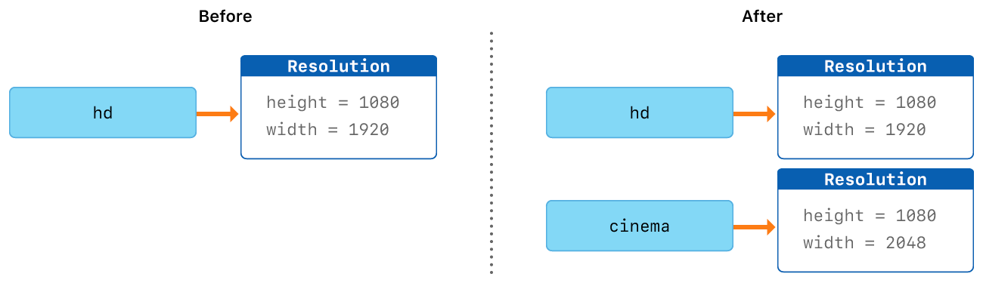
Notes:
NOTE
Collections defined by the standard library like arrays, dictionaries, and strings use an optimization to reduce the performance cost of copying. Instead of making a copy immediately, these collections share the memory where the elements are stored between the original instance and any copies. If one of the copies of the collection is modified, the elements are copied just before the modification. The behavior you see in your code is always as if a copy took place immediately.

Slide 192
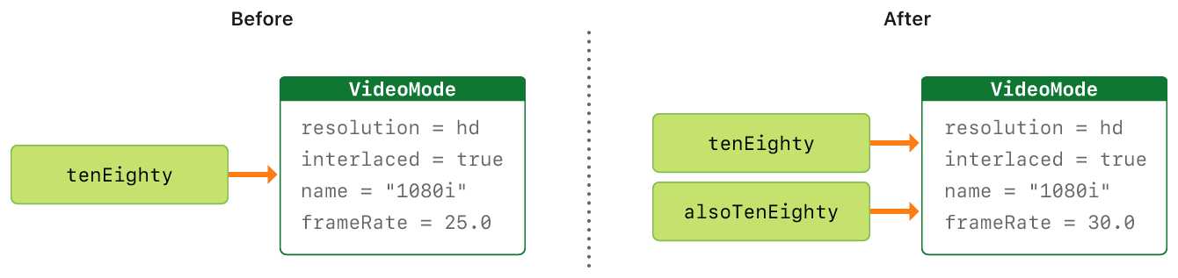
Classes Are Reference Types
let tenEighty = VideoMode() tenEighty.resolution = hd tenEighty.interlaced = true tenEighty.name = "1080i" tenEighty.frameRate = 25.0
let alsoTenEighty = tenEighty alsoTenEighty.frameRate = 30.0
print("The frameRate property of tenEighty is now \(tenEighty.frameRate)") // Prints "The frameRate property of tenEighty is now 30.0"

Slide 193
Identity Operators
Identical to (===)
Not identical to (!==)
if tenEighty === alsoTenEighty { print("tenEighty and alsoTenEighty refer to the same VideoMode instance.") } // Prints "tenEighty and alsoTenEighty refer to the same VideoMode instance."

Slide 194
Pointers
The standard library provides pointer and buffer types that you can use if you need to interact with pointers directly—see Manual Memory Management.

Slide 195
Properties
Stored Properties
Computed Properties
Property Observers
Global and Local Variables
Type Properties
Notes:
Properties associate values with a particular class, structure, or enumeration. Stored properties store constant and variable values as part of an instance, whereas computed properties calculate (rather than store) a value. Computed properties are provided by classes, structures, and enumerations. Stored properties are provided only by classes and structures.

Slide 196
Properties associate values with a particular class, structure, or enumeration.
Stored properties are provided only by classes and structures.
Computed properties are provided by classes, structures, and enumerations.
type properties
property observers

Slide 197
Stored Properties
struct FixedLengthRange { var firstValue: Int let length: Int } var rangeOfThreeItems = FixedLengthRange(firstValue: 0, length: 3) // the range represents integer values 0, 1, and 2 rangeOfThreeItems.firstValue = 6 // the range now represents integer values 6, 7, and 8

Slide 198
Stored Properties of Constant Structure Instances
let rangeOfFourItems = FixedLengthRange(firstValue: 0, length: 4) // this range represents integer values 0, 1, 2, and 3 rangeOfFourItems.firstValue = 6 // this will report an error, even though firstValue is a variable property

Slide 199
Lazy Stored Properties
class DataImporter { /* DataImporter is a class to import data from an external file. The class is assumed to take a nontrivial amount of time to initialize. */ var filename = "data.txt" // the DataImporter class would provide data importing functionality here } class DataManager { lazy var importer = DataImporter() var data = [String]() // the DataManager class would provide data management functionality here } let manager = DataManager() manager.data.append("Some data") manager.data.append("Some more data") // the DataImporter instance for the importer property has not yet been created
Notes:
NOTE
You must always declare a lazy property as a variable (with the var keyword), because its initial value might not be retrieved until after instance initialization completes. Constant properties must always have a value before initialization completes, and therefore cannot be declared as lazy.

Slide 200
print(manager.importer.filename) // the DataImporter instance for the importer property has now been created // Prints "data.txt"
Notes:
NOTE
If a property marked with the lazy modifier is accessed by multiple threads simultaneously and the property has not yet been initialized, there is no guarantee that the property will be initialized only once.

Slide 201
Stored Properties and Instance Variables
Objective-C : provides two ways to store values and references as part of a class instance.
Swift : A Swift property does not have a corresponding instance variable, and the backing store for a property is not accessed directly

Slide 202
Computed Properties
struct Point { var x = 0.0, y = 0.0 } struct Size { var width = 0.0, height = 0.0 } struct Rect { var origin = Point() var size = Size() var center: Point { get { let centerX = origin.x + (size.width / 2) let centerY = origin.y + (size.height / 2) return Point(x: centerX, y: centerY) }

Slide 203
set(newCenter) { origin.x = newCenter.x - (size.width / 2) origin.y = newCenter.y - (size.height / 2) } } } var square = Rect(origin: Point(x: 0.0, y: 0.0), size: Size(width: 10.0, height: 10.0)) let initialSquareCenter = square.center square.center = Point(x: 15.0, y: 15.0) print("square.origin is now at (\(square.origin.x), \(square.origin.y))") // Prints "square.origin is now at (10.0, 10.0)"
Point encapsulates the x- and y-coordinate of a point.
Size encapsulates a width and a height.
Rect defines a rectangle by an origin point and a size.

Slide 204
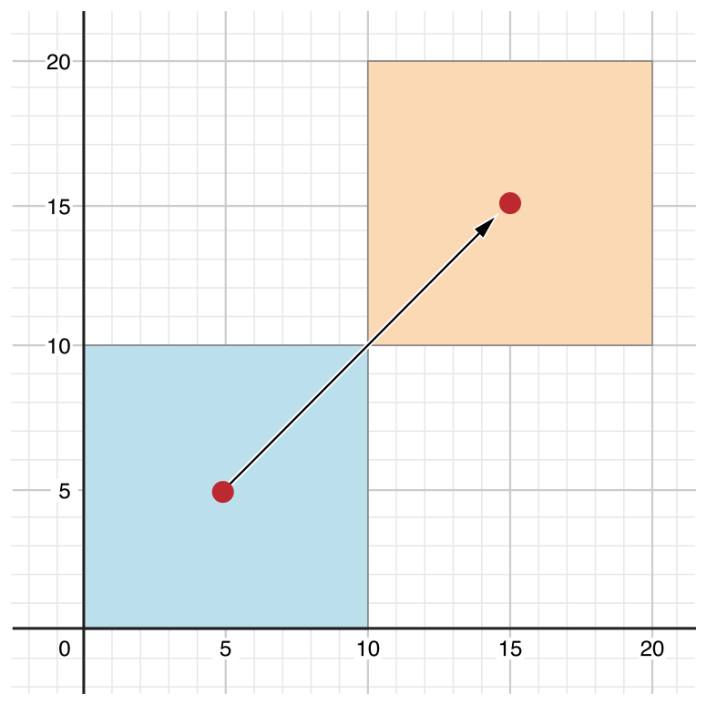

Slide 205
Shorthand Setter Declaration
struct AlternativeRect { var origin = Point() var size = Size() var center: Point { get { let centerX = origin.x + (size.width / 2) let centerY = origin.y + (size.height / 2) return Point(x: centerX, y: centerY) } set { origin.x = newValue.x - (size.width / 2) origin.y = newValue.y - (size.height / 2) } } }

Slide 206
Read-Only Computed Properties
struct Cuboid { var width = 0.0, height = 0.0, depth = 0.0 var volume: Double { return width * height * depth } } let fourByFiveByTwo = Cuboid(width: 4.0, height: 5.0, depth: 2.0) print("the volume of fourByFiveByTwo is \(fourByFiveByTwo.volume)") // Prints "the volume of fourByFiveByTwo is 40.0"
Notes:
NOTE
You must declare computed properties—including read-only computed properties—as variable properties with the var keyword, because their value is not fixed. The let keyword is only used for constant properties, to indicate that their values cannot be changed once they are set as part of instance initialization.

Slide 207
Property Observers
You can add property observers to any stored properties you define, except for lazy stored properties.
willSet is called just before the value is stored.
didSet is called immediately after the new value is stored.
Notes:
NOTE
The willSet and didSet observers of superclass properties are called when a property is set in a subclass initializer, after the superclass initializer has been called. They are not called while a class is setting its own properties, before the superclass initializer has been called.
For more information about initializer delegation, see Initializer Delegation for Value Types and Initializer Delegation for Class Types.

Slide 208
class StepCounter { var totalSteps: Int = 0 { willSet(newTotalSteps) { print("About to set totalSteps to \(newTotalSteps)") } didSet { if totalSteps > oldValue { print("Added \(totalSteps - oldValue) steps") } } } } let stepCounter = StepCounter() stepCounter.totalSteps = 200 // About to set totalSteps to 200 // Added 200 steps stepCounter.totalSteps = 360 // About to set totalSteps to 360 // Added 160 steps stepCounter.totalSteps = 896 // About to set totalSteps to 896 // Added 536 steps

Slide 209
Global and Local Variables
Global variables are variables that are defined outside of any function, method, closure, or type context.
Local variables are variables that are defined within a function, method, or closure context.
Notes:
NOTE
Global constants and variables are always computed lazily, in a similar manner to Lazy Stored Properties. Unlike lazy stored properties, global constants and variables do not need to be marked with the lazy modifier.
Local constants and variables are never computed lazily.

Slide 210
Type Properties
Type Property Syntax
struct SomeStructure { static var storedTypeProperty = "Some value." static var computedTypeProperty: Int { return 1 } } enum SomeEnumeration { static var storedTypeProperty = "Some value." static var computedTypeProperty: Int { return 6 } }
Notes:
NOTE
Unlike stored instance properties, you must always give stored type properties a default value. This is because the type itself does not have an initializer that can assign a value to a stored type property at initialization time.
Stored type properties are lazily initialized on their first access. They are guaranteed to be initialized only once, even when accessed by multiple threads simultaneously, and they do not need to be marked with the lazy modifier.

Slide 211
Type Property Syntax
class SomeClass { static var storedTypeProperty = "Some value." static var computedTypeProperty: Int { return 27 } class var overrideableComputedTypeProperty: Int { return 107 } }
Notes:
NOTE
The computed type property examples above are for read-only computed type properties, but you can also define read-write computed type properties with the same syntax as for computed instance properties.

Slide 212
Querying and Setting Type Properties
print(SomeStructure.storedTypeProperty) // Prints "Some value." SomeStructure.storedTypeProperty = "Another value." print(SomeStructure.storedTypeProperty) // Prints "Another value." print(SomeEnumeration.computedTypeProperty) // Prints "6" print(SomeClass.computedTypeProperty) // Prints "27"

Slide 213
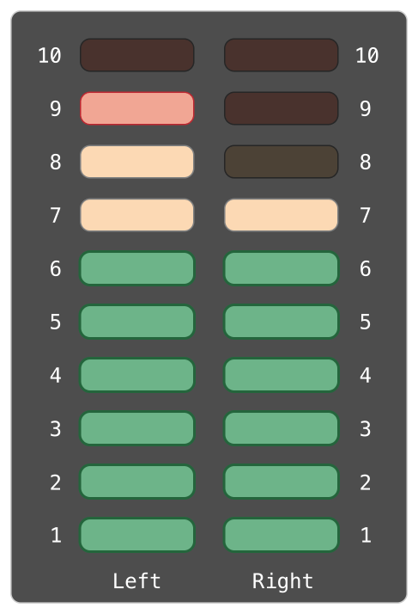

Slide 214
struct AudioChannel { static let thresholdLevel = 10 static var maxInputLevelForAllChannels = 0 var currentLevel: Int = 0 { didSet { if currentLevel > AudioChannel.thresholdLevel { // cap the new audio level to the threshold level
currentLevel = AudioChannel.thresholdLevel } if currentLevel > AudioChannel.maxInputLevelForAllChannels { // store this as the new overall maximum input level AudioChannel.maxInputLevelForAllChannels = currentLevel } } } }
Notes:
NOTE
In the first of these two checks, the didSet observer sets currentLevel to a different value. This does not, however, cause the observer to be called again.

Slide 215
var leftChannel = AudioChannel() var rightChannel = AudioChannel()
leftChannel.currentLevel = 7 print(leftChannel.currentLevel) // Prints "7" print(AudioChannel.maxInputLevelForAllChannels) // Prints "7"
rightChannel.currentLevel = 11 print(rightChannel.currentLevel) // Prints "10" print(AudioChannel.maxInputLevelForAllChannels) // Prints "10"

Slide 216
Methods
Instance Methods
The self Property
Modifying Value Types from Within Instance Methods
Assigning to self Within a Mutating Method
Type Methods
Notes:
The fact that structures and enumerations can define methods in Swift is a major difference from C and Objective-C. In Objective-C, classes are the only types that can define methods. In Swift, you can choose whether to define a class, structure, or enumeration, and still have the flexibility to define methods on the type you create.

Slide 217
Instance Methods
class Counter { var count = 0 func increment() { count += 1 } func increment(by amount: Int) { count += amount } func reset() { count = 0 } }

Slide 218
let counter = Counter() // the initial counter value is 0 counter.increment() // the counter's value is now 1 counter.increment(by: 5) // the counter's value is now 6 counter.reset() // the counter's value is now 0

Slide 219
The self Property
func increment() { self.count += 1 }

Slide 220
struct Point { var x = 0.0, y = 0.0 func isToTheRightOf(x: Double) -> Bool { return self.x > x } } let somePoint = Point(x: 4.0, y: 5.0) if somePoint.isToTheRightOf(x: 1.0) { print("This point is to the right of the line where x == 1.0") } // Prints "This point is to the right of the line where x == 1.0"

Slide 221
Modifying Value Types from Within Instance Methods
struct Point { var x = 0.0, y = 0.0 mutating func moveBy(x deltaX: Double, y deltaY: Double) { x += deltaX y += deltaY } } var somePoint = Point(x: 1.0, y: 1.0) somePoint.moveBy(x: 2.0, y: 3.0) print("The point is now at (\(somePoint.x), \(somePoint.y))") // Prints "The point is now at (3.0, 4.0)"

Slide 222
let fixedPoint = Point(x: 3.0, y: 3.0) fixedPoint.moveBy(x: 2.0, y: 3.0) // this will report an error

Slide 223
Assigning to self Within a Mutating Method
struct Point { var x = 0.0, y = 0.0 mutating func moveBy(x deltaX: Double, y deltaY: Double) { self = Point(x: x + deltaX, y: y + deltaY) } }

Slide 224
enum TriStateSwitch { case off, low, high mutating func next() { switch self { case .off: self = .low case .low: self = .high case .high: self = .off } } } var ovenLight = TriStateSwitch.low ovenLight.next() // ovenLight is now equal to .high ovenLight.next() // ovenLight is now equal to .off
Notes:
This example defines an enumeration for a three-state switch. The switch cycles between three different power states (off, low and high) every time its next() method is called.

Slide 225
Type Methods
struct LevelTracker { static var highestUnlockedLevel = 1 var currentLevel = 1 static func unlock(_ level: Int) { if level > highestUnlockedLevel { highestUnlockedLevel = level } } static func isUnlocked(_ level: Int) -> Bool { return level <= highestUnlockedLevel } @discardableResult mutating func advance(to level: Int) -> Bool { if LevelTracker.isUnlocked(level) { currentLevel = level return true } else { return false } } }
Notes:
Instance methods, as described above, are methods that are called on an instance of a particular type. You can also define methods that are called on the type itself. These kinds of methods are called type methods. You indicate type methods by writing the static keyword before the method’s func keyword. Classes may also use the class keyword to allow subclasses to override the superclass’s implementation of that method.
NOTE
In Objective-C, you can define type-level methods only for Objective-C classes. In Swift, you can define type-level methods for all classes, structures, and enumerations. Each type method is explicitly scoped to the type it supports.

Slide 226
class Player { var tracker = LevelTracker() let playerName: String func complete(level: Int) { LevelTracker.unlock(level + 1) tracker.advance(to: level + 1) } init(name: String) { playerName = name } }

Slide 227
var player = Player(name: "Argyrios") player.complete(level: 1) print("highest unlocked level is now \(LevelTracker.highestUnlockedLevel)") // Prints "highest unlocked level is now 2"
player = Player(name: "Beto")
if player.tracker.advance(to: 6) { print("player is now on level 6") } else { print("level 6 has not yet been unlocked") }
// Prints "level 6 has not yet been unlocked"

Slide 228
Subscripts
Subscript Syntax
Subscript Usage
Subscript Options

Slide 229
Inheritance
Defining a Base Class
Subclassing
Overriding
Accessing Superclass Methods, Properties, and Subscripts
Overriding Methods
Overriding Properties
Preventing Overrides

Slide 230
Defining a Base Class
class Vehicle {
var currentSpeed = 0.0
var description: String { return "traveling at \(currentSpeed) miles per hour" } func makeNoise() { // do nothing - an arbitrary vehicle doesn't necessarily make a noise
}
}
let someVehicle = Vehicle()
print("Vehicle: \(someVehicle.description)")
// Vehicle: traveling at 0.0 miles per hour
Notes:
NOTE
Swift classes do not inherit from a universal base class. Classes you define without specifying a superclass automatically become base classes for you to build upon. The example below defines a base class called Vehicle. This base class defines a stored property called currentSpeed, with a default value of 0.0 (inferring a property type of Double). The currentSpeed property’s value is used by a read-only computed Stringproperty called description to create a description of the vehicle.

Slide 231
Subclassing
class SomeSubclass: SomeSuperclass {
// subclass definition goes here
}
class Bicycle: Vehicle {
var hasBasket = false
}
let bicycle = Bicycle() bicycle.hasBasket = true
bicycle.currentSpeed = 15.0 print("Bicycle: \(bicycle.description)") // Bicycle: traveling at 15.0 miles per hour
Notes:
Subclassing is the act of basing a new class on an existing class. The subclass inherits characteristics from the existing class, which you can then refine. You can also add new characteristics to the subclass.

Slide 232
class Tandem: Bicycle { var currentNumberOfPassengers = 0 }
let tandem = Tandem() tandem.hasBasket = true tandem.currentNumberOfPassengers = 2 tandem.currentSpeed = 22.0 print("Tandem: \(tandem.description)") // Tandem: traveling at 22.0 miles per hour
Notes:
Subclassing is the act of basing a new class on an existing class. The subclass inherits characteristics from the existing class, which you can then refine. You can also add new characteristics to the subclass.

Slide 233
Overriding
Accessing Superclass Methods, Properties, and Subscripts
An overridden method named someMethod() can call the superclass version of someMethod() by calling super.someMethod() within the overriding method implementation.
An overridden property called someProperty can access the superclass version of someProperty as super.someProperty within the overriding getter or setter implementation.
An overridden subscript for someIndex can access the superclass version of the same subscript as super[someIndex] from within the overriding subscript implementation.
Notes:
A subclass can provide its own custom implementation of an instance method, type method, instance property, type property, or subscript that it would otherwise inherit from a superclass. This is known as overriding.

Slide 234
Overriding Methods
class Train: Vehicle { override func makeNoise() { print("Choo Choo") } }
let train = Train() train.makeNoise() // Prints "Choo Choo"
Notes:
You can override an inherited instance or type method to provide a tailored or alternative implementation of the method within your subclass.
The following example defines a new subclass of Vehicle called Train, which overrides the makeNoise() method that Train inherits from Vehicle:

Slide 235
Overriding Property
Overriding Property Getters and Setters
class Car: Vehicle { var gear = 1 override var description: String { return super.description + " in gear \(gear)" } }
let car = Car() car.currentSpeed = 25.0 car.gear = 3 print("Car: \(car.description)") // Car: traveling at 25.0 miles per hour in gear 3
Notes:
You can provide a custom getter (and setter, if appropriate) to override any inherited property, regardless of whether the inherited property is implemented as a stored or computed property at source.
You can present an inherited read-only property as a read-write property by providing both a getter and a setter in your subclass property override. You cannot, however, present an inherited read-write property as a read-only property.
NOTE
If you provide a setter as part of a property override, you must also provide a getter for that override. If you don’t want to modify the inherited property’s value within the overriding getter, you can simply pass through the inherited value by returning super.someProperty from the getter, where someProperty is the name of the property you are overriding.
The following example defines a new class called Car, which is a subclass of Vehicle. The Car class introduces a new stored property called gear, with a default integer value of 1. The Car class also overrides the description property it inherits from Vehicle, to provide a custom description that includes the current gear:

Slide 236
Overriding Property
Overriding Property Observers
class AutomaticCar: Car { override var currentSpeed: Double { didSet { gear = Int(currentSpeed / 10.0) + 1 } } }
let automatic = AutomaticCar() automatic.currentSpeed = 35.0 print("AutomaticCar: \(automatic.description)") // AutomaticCar: traveling at 35.0 miles per hour in gear 4
Notes:
You can use property overriding to add property observers to an inherited property. This enables you to be notified when the value of an inherited property changes, regardless of how that property was originally implemented.
NOTE
You cannot add property observers to inherited constant stored properties or inherited read-only computed properties. The value of these properties cannot be set, and so it is not appropriate to provide a willSet or didSet implementation as part of an override.
Note also that you cannot provide both an overriding setter and an overriding property observer for the same property. If you want to observe changes to a property’s value, and you are already providing a custom setter for that property, you can simply observe any value changes from within the custom setter.

Slide 237
Preventing Overrides
Prevent a method, property, or subscript from being overridden by marking it as final.
final var
final func
final class func
final subscript
final class
Notes:
Any attempt to override a final method, property, or subscript in a subclass is reported as a compile-time error. Methods, properties, or subscripts that you add to a class in an extension can also be marked as final within the extension’s definition.
Any attempt to override a final method, property, or subscript in a subclass is reported as a compile-time error. Methods, properties, or subscripts that you add to a class in an extension can also be marked as final within the extension’s definition.

Slide 238
Initialization
Setting Initial Values for Stored Properties
Customizing Initialization
Default Initializers
Initializer Delegation for Value Types
Class Inheritance and Initialization
Failable Initializers
Required Initializers
Setting a Default Property Value with a Closure or Function
Notes:
Initialization is the process of preparing an instance of a class, structure, or enumeration for use.
You implement this initialization process by defining initializers, which are like special methods that can be called to create a new instance of a particular type.
Instances of class types can also implement a deinitializer, which performs any custom cleanup just before an instance of that class is deallocated.

Slide 239
Setting Initial Values for Stored Properties
Initializers
struct Fahrenheit { var temperature: Double init() { temperature = 32.0 } } var f = Fahrenheit() print("The default temperature is \(f.temperature)° Fahrenheit") // Prints "The default temperature is 32.0° Fahrenheit"
Notes:
Classes and structures must set all of their stored properties to an appropriate initial value by the time an instance of that class or structure is created. Stored properties cannot be left in an indeterminate state.
You can set an initial value for a stored property within an initializer, or by assigning a default property value as part of the property’s definition.
NOTE
When you assign a default value to a stored property, or set its initial value within an initializer, the value of that property is set directly, without calling any property observers.

Slide 240
Default Property Values
struct Fahrenheit { var temperature = 32.0 }
Notes:
NOTE
If a property always takes the same initial value, provide a default value rather than setting a value within an initializer. The end result is the same, but the default value ties the property’s initialization more closely to its declaration. It makes for shorter, clearer initializers and enables you to infer the type of the property from its default value. The default value also makes it easier for you to take advantage of default initializers and initializer inheritance, as described later in this chapter.

Slide 241
Customizing Initialization
Initialization Parameters
struct Celsius { var temperatureInCelsius: Double init(fromFahrenheit fahrenheit: Double) { temperatureInCelsius = (fahrenheit - 32.0) / 1.8 } init(fromKelvin kelvin: Double) { temperatureInCelsius = kelvin - 273.15 } } let boilingPointOfWater = Celsius(fromFahrenheit: 212.0) // boilingPointOfWater.temperatureInCelsius is 100.0 let freezingPointOfWater = Celsius(fromKelvin: 273.15) // freezingPointOfWater.temperatureInCelsius is 0.0
Notes:
Initialization parameters have the same capabilities and syntax as function and method parameters.
The first initializer has a single initialization parameter with an argument label of fromFahrenheit and a parameter name of fahrenheit. The second initializer has a single initialization parameter with an argument label of fromKelvin and a parameter name of kelvin.

Slide 242
Parameter Names and Argument Labels
struct Color { let red, green, blue: Double init(red: Double, green: Double, blue: Double) { self.red = red self.green = green self.blue = blue } init(white: Double) { red = white green = white blue = white } }
Notes:
Swift provides an automatic argument label for every parameter in an initializer if you don’t provide one.

Slide 243
let magenta = Color(red: 1.0, green: 0.0, blue: 1.0) let halfGray = Color(white: 0.5)
Without using argument label, compiler error
let veryGreen = Color(0.0, 1.0, 0.0) // this reports a compile-time error - argument labels are required
Notes:
Both initializers can be used to create a new Color instance, by providing named values for each initializer parameter:
Note that it is not possible to call these initializers without using argument labels. Argument labels must always be used in an initializer if they are defined, and omitting them is a compile-time error:

Slide 244
Initializer Parameters Without Argument Labels
struct Celsius { var temperatureInCelsius: Double init(fromFahrenheit fahrenheit: Double) { temperatureInCelsius = (fahrenheit - 32.0) / 1.8 } init(fromKelvin kelvin: Double) { temperatureInCelsius = kelvin - 273.15 } init(_ celsius: Double) { temperatureInCelsius = celsius } } let bodyTemperature = Celsius(37.0) // bodyTemperature.temperatureInCelsius is 37.0
Notes:
If you do not want to use an argument label for an initializer parameter, write an underscore (_) instead of an explicit argument label for that parameter to override the default behavior.

Slide 245
Optional Property Types
class SurveyQuestion { var text: String var response: String? init(text: String) { self.text = text } func ask() { print(text) } } let cheeseQuestion = SurveyQuestion(text: "Do you like cheese?") cheeseQuestion.ask() // Prints "Do you like cheese?" cheeseQuestion.response = "Yes, I do like cheese."
Notes:
If your custom type has a stored property that is logically allowed to have “no value”—perhaps because its value cannot be set during initialization, or because it is allowed to have “no value” at some later point—declare the property with an optional type. Properties of optional type are automatically initialized with a value of nil, indicating that the property is deliberately intended to have “no value yet” during initialization.

Slide 246
Assigning Constant Properties During Initialization
class SurveyQuestion { let text: String var response: String? init(text: String) { self.text = text } func ask() { print(text) } } let beetsQuestion = SurveyQuestion(text: "How about beets?") beetsQuestion.ask() // Prints "How about beets?" beetsQuestion.response = "I also like beets. (But not with cheese.)"
Notes:
You can assign a value to a constant property at any point during initialization, as long as it is set to a definite value by the time initialization finishes. Once a constant property is assigned a value, it can’t be further modified.
NOTE
For class instances, a constant property can be modified during initialization only by the class that introduces it. It cannot be modified by a subclass.

Slide 247
Default Initializers
class ShoppingListItem { var name: String? //->nil var quantity = 1 var purchased = false
}
var item = ShoppingListItem()
Notes:
Swift provides a default initializer for any structure or class that provides default values for all of its properties and does not provide at least one initializer itself. The default initializer simply creates a new instance with all of its properties set to their default values.
The example above uses the default initializer for the ShoppingListItem class to create a new instance of the class with initializer syntax, written as ShoppingListItem(), and assigns this new instance to a variable called item.

Slide 248
Memberwise Initializers for Structure Types
struct Size { var width = 0.0, height = 0.0 } let twoByTwo = Size(width: 2.0, height: 2.0)
Notes:
Structure types automatically receive a memberwise initializer if they do not define any of their own custom initializers. Unlike a default initializer, the structure receives a memberwise initializer even if it has stored properties that do not have default values. The example below defines a structure called Size with two properties called width and height. Both properties are inferred to be of type Double by assigning a default value of 0.0.
The Size structure automatically receives an init(width:height:) memberwise initializer, which you can use to initialize a new Size instance:

Slide 249
Initializer Delegation for Value Types
Initializers can call other initializers to perform part of an instance’s initialization. This process, known as initializer delegation, avoids duplicating code across multiple initializers.
struct Size { var width = 0.0, height = 0.0 } struct Point { var x = 0.0, y = 0.0 }
Notes:
NOTE
If you want your custom value type to be initializable with the default initializer and memberwise initializer, and also with your own custom initializers, write your custom initializers in an extension rather than as part of the value type’s original implementation. For more information, see Extensions.

Slide 250
struct Rect { var origin = Point() var size = Size() init() {} init(origin: Point, size: Size) { self.origin = origin self.size = size } init(center: Point, size: Size) { let originX = center.x - (size.width / 2) let originY = center.y - (size.height / 2) self.init(origin: Point(x: originX, y: originY), size: size) } }

Slide 251
Initializers can call other initializers to perform part of an instance’s initialization. This process, known
let basicRect = Rect() // basicRect's origin is (0.0, 0.0) and its size is (0.0, 0.0)
let originRect = Rect(origin: Point(x: 2.0, y: 2.0), size: Size(width: 5.0, height: 5.0)) // originRect's origin is (2.0, 2.0) and its size is (5.0, 5.0)
let centerRect = Rect(center: Point(x: 4.0, y: 4.0), size: Size(width: 3.0, height: 3.0)) // centerRect's origin is (2.5, 2.5) and its size is (3.0, 3.0)
Notes:
NOTE
For an alternative way to write this example without defining the init() and init(origin:size:)initializers yourself, see Extensions.

Slide 252
Class Inheritance and Initialization
All of a class’s stored properties—including any properties the class inherits from its superclass—must be assigned an initial value during initialization.

Slide 253
Designated Initializers and Convenience Initializers
Designated initializers are the primary initializers for a class. A designated initializer fully initializes all properties introduced by that class and calls an appropriate superclass initializer to continue the initialization process up the superclass chain.
Convenience initializers are secondary, supporting initializers for a class.

Slide 254
Syntax for Designated and Convenience Initializers
Designated initializers
init(parameters) { statements }
Convenience initializers
convenience init(parameters) { statements }

Slide 255
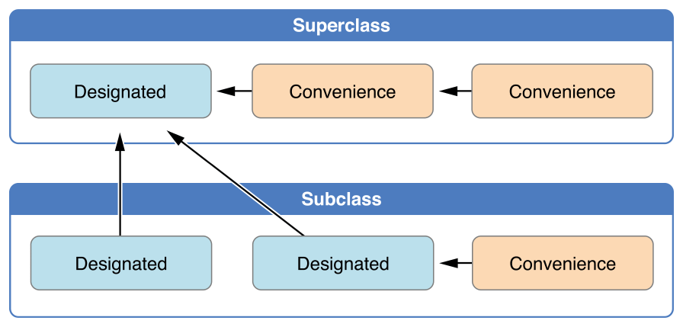
Initializer Delegation for Class Types
Rule 1 : A designated initializer must call a designated initializer from its immediate superclass.
Rule 2 : A convenience initializer must call another initializer from the same class.
Rule 3 : A convenience initializer must ultimately call a designated initializer.
A simple way:
Designated initializers must always delegate up.
Convenience initializers must always delegate across.
Notes:
NOTE
These rules don’t affect how users of your classes create instances of each class. Any initializer in the diagram above can be used to create a fully-initialized instance of the class they belong to. The rules only affect how you write the implementation of the class’s initializers.

Slide 256
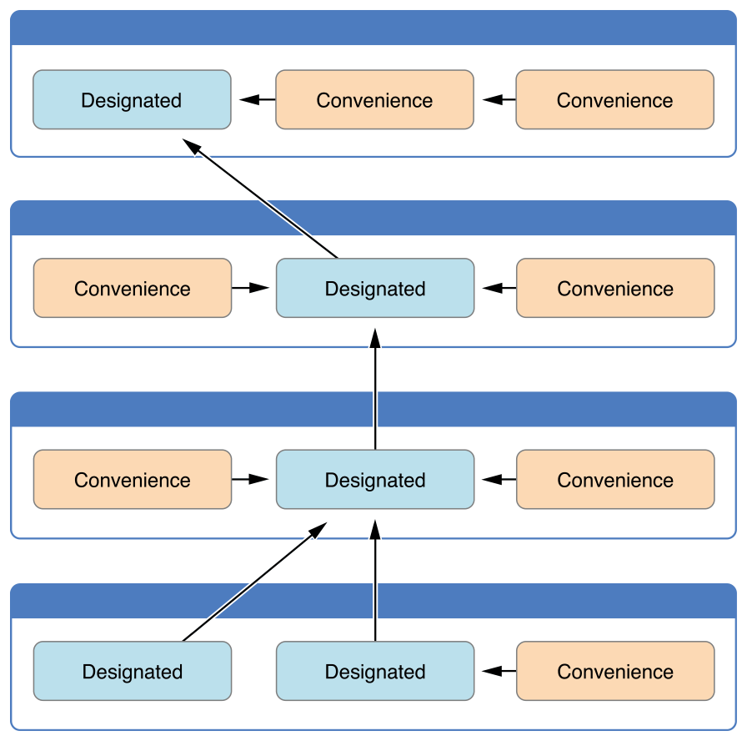

Slide 257
Two-Phase Initialization
Safety check 1
Safety check 2
Safety check 3
Safety check 4
Phase 1
Phase 2
Notes:
NOTE
Swift’s two-phase initialization process is similar to initialization in Objective-C. The main difference is that during phase 1, Objective-C assigns zero or null values (such as 0 or nil) to every property. Swift’s initialization flow is more flexible in that it lets you set custom initial values, and can cope with types for which 0 or nil is not a valid default value.

Slide 258
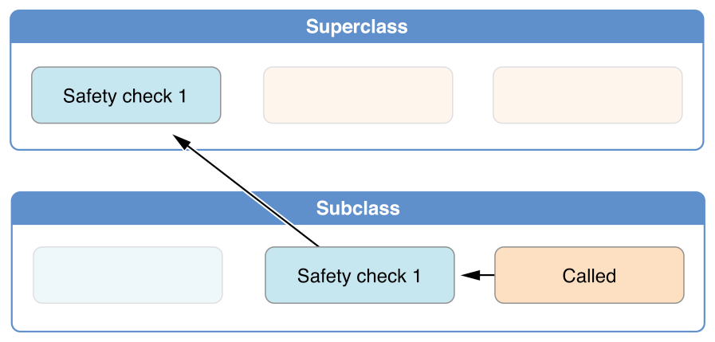
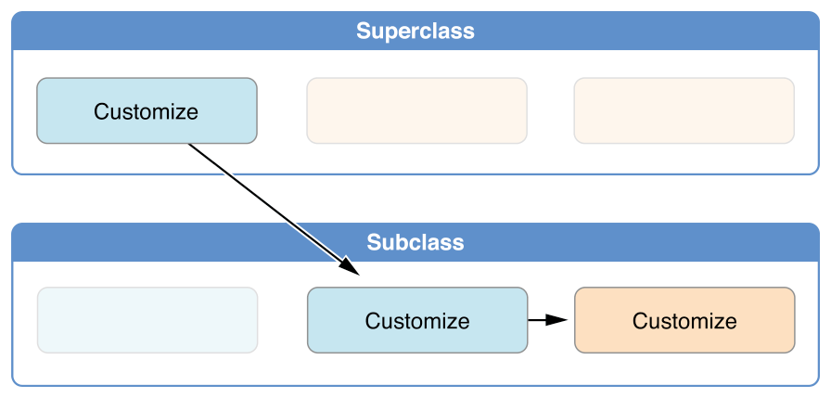
Notes:
NOTE
Swift’s two-phase initialization process is similar to initialization in Objective-C. The main difference is that during phase 1, Objective-C assigns zero or null values (such as 0 or nil) to every property. Swift’s initialization flow is more flexible in that it lets you set custom initial values, and can cope with types for which 0 or nil is not a valid default value.

Slide 259
Initializer Inheritance and Overriding
class Vehicle { var numberOfWheels = 0 var description: String { return "\(numberOfWheels) wheel(s)" } }
let vehicle = Vehicle() print("Vehicle: \(vehicle.description)") // Vehicle: 0 wheel(s)
Notes:
NOTE
Superclass initializers are inherited in certain circumstances, but only when it is safe and appropriate to do so. For more information, see Automatic Initializer Inheritance below.
NOTE
You always write the override modifier when overriding a superclass designated initializer, even if your subclass’s implementation of the initializer is a convenience initializer.

Slide 260
class Bicycle: Vehicle { override init() { super.init() numberOfWheels = 2 } }
let bicycle = Bicycle() print("Bicycle: \(bicycle.description)") // Bicycle: 2 wheel(s)
Notes:
NOTE
Subclasses can modify inherited variable properties during initialization, but can not modify inherited constant properties.

Slide 261
Automatic Initializer Inheritance
Rule 1 : If your subclass doesn’t define any designated initializers, it automatically inherits all of its superclass designated initializers.
Rule 2 : If your subclass provides an implementation of all of its superclass designated initializers—either by inheriting them as per rule 1, or by providing a custom implementation as part of its definition—then it automatically inherits all of the superclass convenience initializers.
Notes:
NOTE
A subclass can implement a superclass designated initializer as a subclass convenience initializer as part of satisfying rule 2.

Slide 262
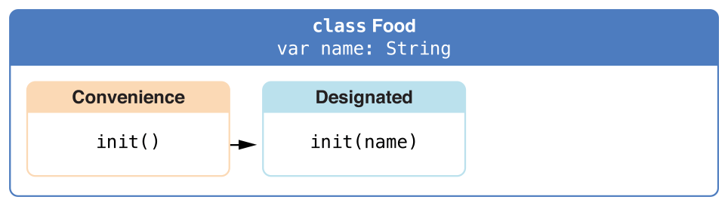
Designated and Convenience Initializers in Action
class Food { var name: String init(name: String) { self.name = name } convenience init() { self.init(name: "[Unnamed]") } }

Slide 263
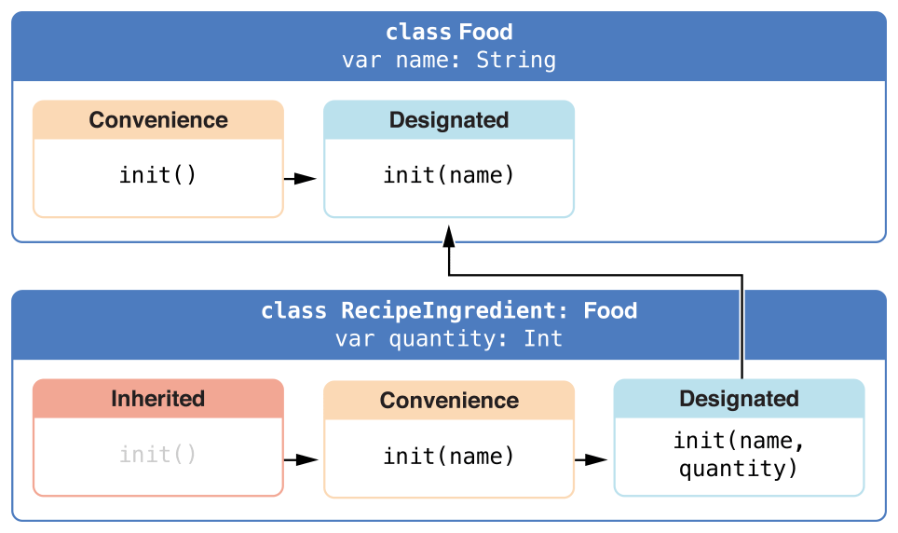
let namedMeat = Food(name: "Bacon") // namedMeat's name is "Bacon"
let mysteryMeat = Food() // mysteryMeat's name is "[Unnamed]"
class RecipeIngredient: Food { var quantity: Int init(name: String, quantity: Int) { self.quantity = quantity super.init(name: name) } override convenience init(name: String) { self.init(name: name, quantity: 1) } }

Slide 264
let oneMysteryItem = RecipeIngredient() let oneBacon = RecipeIngredient(name: "Bacon") let sixEggs = RecipeIngredient(name: "Eggs", quantity: 6)
class ShoppingListItem: RecipeIngredient { var purchased = false var description: String { var output = "\(quantity) x \(name)" output += purchased ? " ✔" : " ✘" return output } }
Notes:
NOTE
ShoppingListItem does not define an initializer to provide an initial value for purchased, because items in a shopping list (as modeled here) always start out unpurchased.

Slide 265
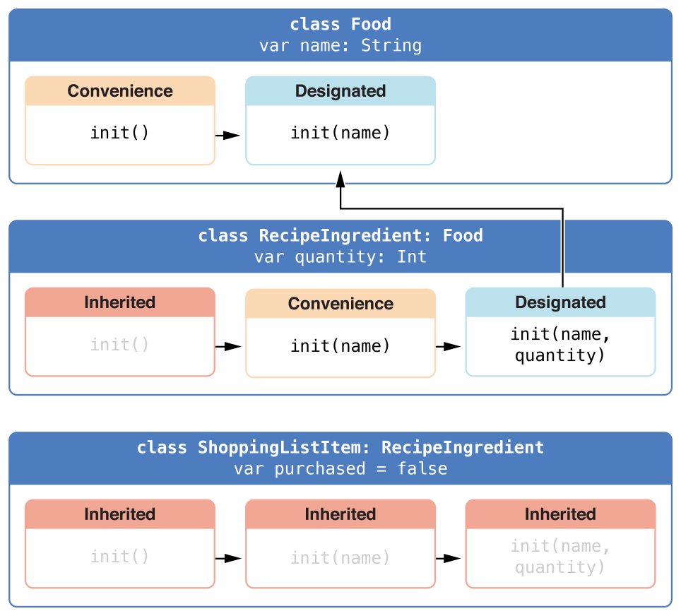
var breakfastList = [ ShoppingListItem(), ShoppingListItem(name: "Bacon"), ShoppingListItem(name: "Eggs",
quantity: 6), ] breakfastList[0].name = "Orange juice" breakfastList[0].purchased = true for item in breakfastList { print(item.description) } // 1 x Orange juice ✔ // 1 x Bacon ✘ // 6 x Eggs ✘
Notes:
NOTE
ShoppingListItem does not define an initializer to provide an initial value for purchased, because items in a shopping list (as modeled here) always start out unpurchased.

Slide 266
Failable Initializers
let wholeNumber: Double = 12345.0 let pi = 3.14159 if let valueMaintained = Int(exactly: wholeNumber) { print("\(wholeNumber) conversion to Int maintains value of \(valueMaintained)") } // Prints "12345.0 conversion to Int maintains value of 12345" let valueChanged = Int(exactly: pi) // valueChanged is of type Int?, not Int if valueChanged == nil { print("\(pi) conversion to Int does not maintain value") } // Prints "3.14159 conversion to Int does not maintain value"
Notes:
NOTE
You cannot define a failable and a nonfailable initializer with the same parameter types and names.
NOTE
Strictly speaking, initializers do not return a value. Rather, their role is to ensure that self is fully and correctly initialized by the time that initialization ends. Although you write return nil to trigger an initialization failure, you do not use the return keyword to indicate initialization success.

Slide 267
struct Animal { let species: String init?(species: String) { if species.isEmpty { return nil } self.species = species } }
let someCreature = Animal(species: "Giraffe") // someCreature is of type Animal?, not Animal if let giraffe = someCreature { print("An animal was initialized with a species of \(giraffe.species)") } // Prints "An animal was initialized with a species of Giraffe"
let anonymousCreature = Animal(species: "") // anonymousCreature is of type Animal?, not Animal if anonymousCreature == nil { print("The anonymous creature could not be initialized") } // Prints "The anonymous creature could not be initialized"
Notes:
NOTE
You cannot define a failable and a nonfailable initializer with the same parameter types and names.
NOTE
Strictly speaking, initializers do not return a value. Rather, their role is to ensure that self is fully and correctly initialized by the time that initialization ends. Although you write return nil to trigger an initialization failure, you do not use the return keyword to indicate initialization success.

Slide 268
Failable Initializers for Enumerations
enum TemperatureUnit { case kelvin, celsius, fahrenheit init?(symbol: Character) { switch symbol { case "K": self = .kelvin case "C": self = .celsius case "F": self = .fahrenheit default: return nil } } }

Slide 269
let fahrenheitUnit = TemperatureUnit(symbol: "F") if fahrenheitUnit != nil { print("This is a defined temperature unit, so initialization succeeded.") } // Prints "This is a defined temperature unit, so initialization succeeded." let unknownUnit = TemperatureUnit(symbol: "X") if unknownUnit == nil { print("This is not a defined temperature unit, so initialization failed.") } // Prints "This is not a defined temperature unit, so initialization failed."

Slide 270
Failable Initializers for Enumerations with Raw Values
enum TemperatureUnit: Character { case kelvin = "K", celsius = "C", fahrenheit = "F" } let fahrenheitUnit = TemperatureUnit(rawValue: "F") if fahrenheitUnit != nil { print("This is a defined temperature unit, so initialization succeeded.") } // Prints "This is a defined temperature unit, so initialization succeeded." let unknownUnit = TemperatureUnit(rawValue: "X") if unknownUnit == nil { print("This is not a defined temperature unit, so initialization failed.") } // Prints "This is not a defined temperature unit, so initialization failed."

Slide 271
Propagation of Initialization Failure
class Product { let name: String init?(name: String) { if name.isEmpty { return nil } self.name = name } } class CartItem: Product { let quantity: Int init?(name: String, quantity: Int) { if quantity < 1 { return nil } self.quantity = quantity super.init(name: name) } }
Notes:
NOTE
A failable initializer can also delegate to a nonfailable initializer. Use this approach if you need to add a potential failure state to an existing initialization process that does not otherwise fail.

Slide 272
if let twoSocks = CartItem(name: "sock", quantity: 2) { print("Item: \(twoSocks.name), quantity: \(twoSocks.quantity)") } // Prints "Item: sock, quantity: 2"
if let zeroShirts = CartItem(name: "shirt", quantity: 0) { print("Item: \(zeroShirts.name), quantity: \(zeroShirts.quantity)") } else { print("Unable to initialize zero shirts") } // Prints "Unable to initialize zero shirts"
if let oneUnnamed = CartItem(name: "", quantity: 1) { print("Item: \(oneUnnamed.name), quantity: \(oneUnnamed.quantity)") } else { print("Unable to initialize one unnamed product") } // Prints "Unable to initialize one unnamed product"

Slide 273
Overriding a Failable Initializer
class Document { var name: String? // this initializer creates a document with a nil name value init() {} // this initializer creates a document with a nonempty name value init?(name: String) { if name.isEmpty { return nil } self.name = name } }
Notes:
NOTE
You can override a failable initializer with a nonfailable initializer but not the other way around.

Slide 274
class AutomaticallyNamedDocument: Document { override init() { super.init() self.name = "[Untitled]" } override init(name: String) { super.init() if name.isEmpty { self.name = "[Untitled]" } else { self.name = name } } }
class UntitledDocument: Document { override init() { super.init(name: "[Untitled]")! } }
Notes:
NOTE
You can override a failable initializer with a nonfailable initializer but not the other way around.

Slide 275
The init! Failable Initializer

Slide 276
Required Initializers
Write the required modifier before the definition of a class initializer to indicate that every subclass of the class must implement that initializer:
class SomeClass { required init() { // initializer implementation goes here } }
class SomeSubclass: SomeClass { required init() { // subclass implementation of the required initializer goes here } }
Notes:
NOTE
You do not have to provide an explicit implementation of a required initializer if you can satisfy the requirement with an inherited initializer.

Slide 277
Setting a Default Property Value with a Closure or Function
class SomeClass { let someProperty: SomeType = { // create a default value for someProperty inside this closure // someValue must be of the same type as SomeType return someValue }() }
Notes:
NOTE
If you use a closure to initialize a property, remember that the rest of the instance has not yet been initialized at the point that the closure is executed. This means that you cannot access any other property values from within your closure, even if those properties have default values. You also cannot use the implicit self property, or call any of the instance’s methods.

Slide 278


Slide 279
struct Chessboard { let boardColors: [Bool] = { var temporaryBoard = [Bool]() var isBlack = false for i in 1...8 { for j in 1...8 { temporaryBoard.append(isBlack) isBlack = !isBlack } isBlack = !isBlack } return temporaryBoard }() func squareIsBlackAt(row: Int, column: Int) -> Bool { return boardColors[(row * 8) + column] } }

Slide 280
let board = Chessboard() print(board.squareIsBlackAt(row: 0, column: 1)) // Prints "true" print(board.squareIsBlackAt(row: 7, column: 7)) // Prints "false"

Slide 281
Deinitialization
How Deinitialization Works
Deinitializers in Action

Slide 282
Optional Chaining
Optional Chaining as an Alternative to Forced Unwrapping
Defining Model Classes for Optional Chaining
Accessing Properties Through Optional Chaining
Calling Methods Through Optional Chaining
Accessing Subscripts Through Optional Chaining
Linking Multiple Levels of Chaining

Slide 283
Error handling
Representing and Throwing Errors
Handling Errors
Specifying Cleanup Actions

Slide 284
Type Casting
Defining a Class Hierarchy for Type Casting
Checking Type
DownCasting
Type Casting for Any and AnyObject

Slide 285
Nested Types
Nested Types in Action
Referring to Nested Types

Slide 286
Extensions
Extension Syntax
Computed Properties
Initializers
Methods
Subscripts
Nested Types

Slide 287
Protocols
Protocol Syntax
Property Requirements
Method Requirements
Mutating Method Requirements
Initializer Requirements
Protocols as Types
Delegation
Adding Protocol Conformance with an Extension
Collections of Protocol Types
Protocol Inheritance
Class-Only Protocols
Protocol Composition
Checking for Protocol Conformance
Optional Protocol Requirements
Protocol Extensions

Slide 288
Generics
The Problem That Generics Solve
Generic Function
Type Parameters
Naming Type Parameters
Generic Types
Extending a Generic Type
Type Constraints
Associated Types
Generic Where Clauses
Extensions with a Generic Where Clause
Associated Types with a Generic Where Clause
Generic Subscripts

Slide 289
Automatic Reference Counting
How ARC works
ARC in Action
Strong Reference Cycles Between Class Instances
Resolving Strong Reference Cycles Between Class Instances
Strong Reference Cycles for Closures
Resolving Strong Reference Cycles for Closures

Slide 290
Memory Safety
Understanding Conflicting Access to Memroy
Conflicting Access to In-Out Parameters
Conflicting Access to self in Methods
Conflicting Access to Properties

Slide 291
Access Control
Modules and Sources Files
Access Levels
Access Control Syntax
Custom Types
Constants, Variables, Properties, and Subscripts
Initializers
Protocols
Extensions
Generics
Type Aliases
Notes:
NOTE
The various aspects of your code that can have access control applied to them (properties, types, functions, and so on) are referred to as “entities” in the sections below, for brevity.

Slide 292
Access Levels
Open
Public
Internal
File-Private
Private
Notes:
Swift provides five different access levels for entities within your code. These access levels are relative to the source file in which an entity is defined, and also relative to the module that source file belongs to.

Slide 293
Guiding Principle of Access Levels
A public variable can’t be defined as having an internal, file-private, or private type, because the type might not be available everywhere that the public variable is used.
A function can’t have a higher access level than its parameter types and return type, because the function could be used in situations where its constituent types are unavailable to the surrounding code.
Notes:
Access levels in Swift follow an overall guiding principle: No entity can be defined in terms of another entity that has a lower (more restrictive) access level.

Slide 294
Default Access Levels
have a default access level of internal
Notes:
All entities in your code (with a few specific exceptions, as described later in this chapter) have a default access level of internal if you don’t specify an explicit access level yourself. As a result, in many cases you don’t need to specify an explicit access level in your code.

Slide 295
Access Levels for Single-Target Apps
don’t need to specify a custom access level
Notes:
When you write a simple single-target app, the code in your app is typically self-contained within the app and doesn’t need to be made available outside of the app’s module. The default access level of internal already matches this requirement. Therefore, you don’t need to specify a custom access level. You may, however, want to mark some parts of your code as file private or private in order to hide their implementation details from other code within the app’s module.

Slide 296
Access Levels for Frameworks
public-facing interface
Notes:
When you develop a framework, mark the public-facing interface to that framework as open or public so that it can be viewed and accessed by other modules, such as an app that imports the framework. This public-facing interface is the application programming interface (or API) for the framework.
NOTE
Any internal implementation details of your framework can still use the default access level of internal, or can be marked as private or file private if you want to hide them from other parts of the framework’s internal code. You need to mark an entity as open or public only if you want it to become part of your framework’s API.

Slide 297
Access Levels for Unit Test Targets
@testable
Notes:
When you write an app with a unit test target, the code in your app needs to be made available to that module in order to be tested. By default, only entities marked as open or public are accessible to other modules. However, a unit test target can access any internal entity, if you mark the import declaration for a product module with the @testable attribute and compile that product module with testing enabled.

Slide 298
Advanced Operators
Bitwise Operations
Overflow Operators
Precedence and Associativity
Operator Methods
Custom Operators

Slide 299
End

